Slide 1
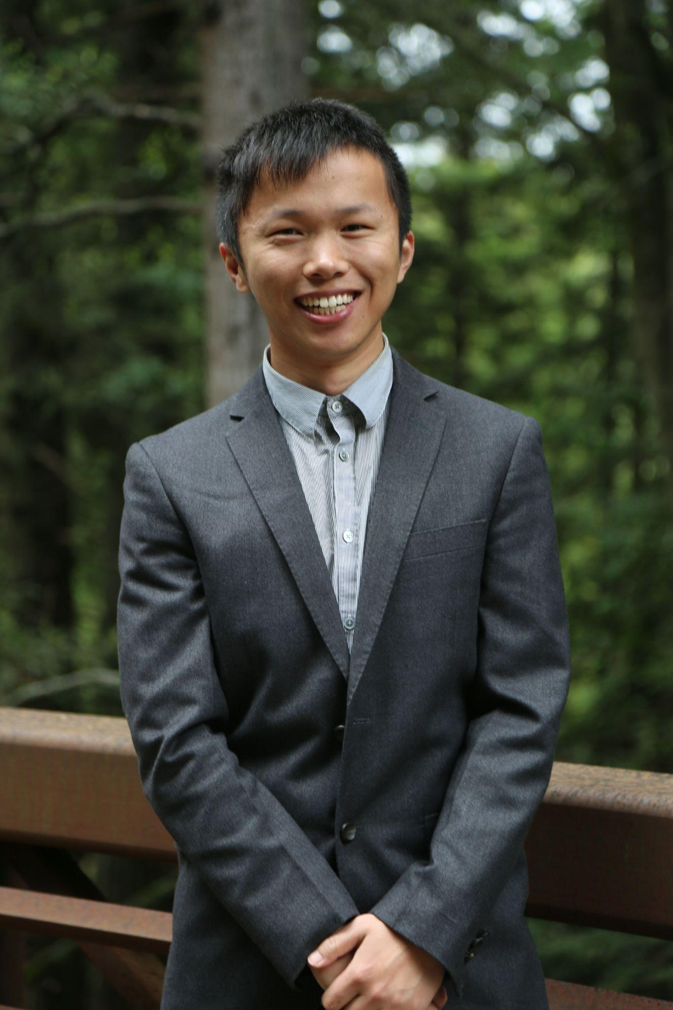
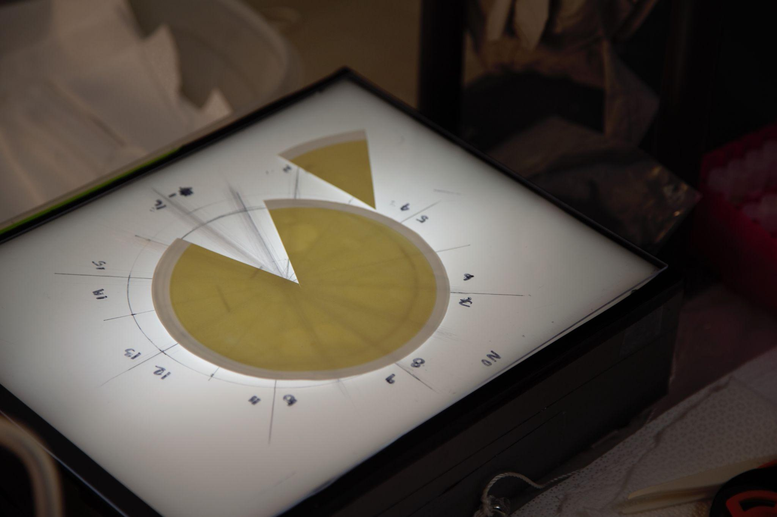
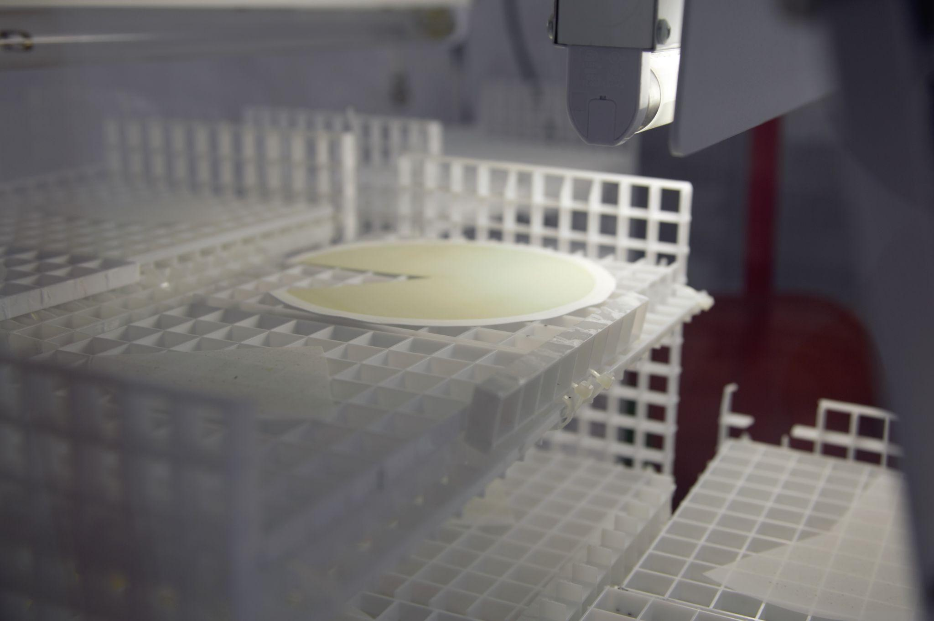


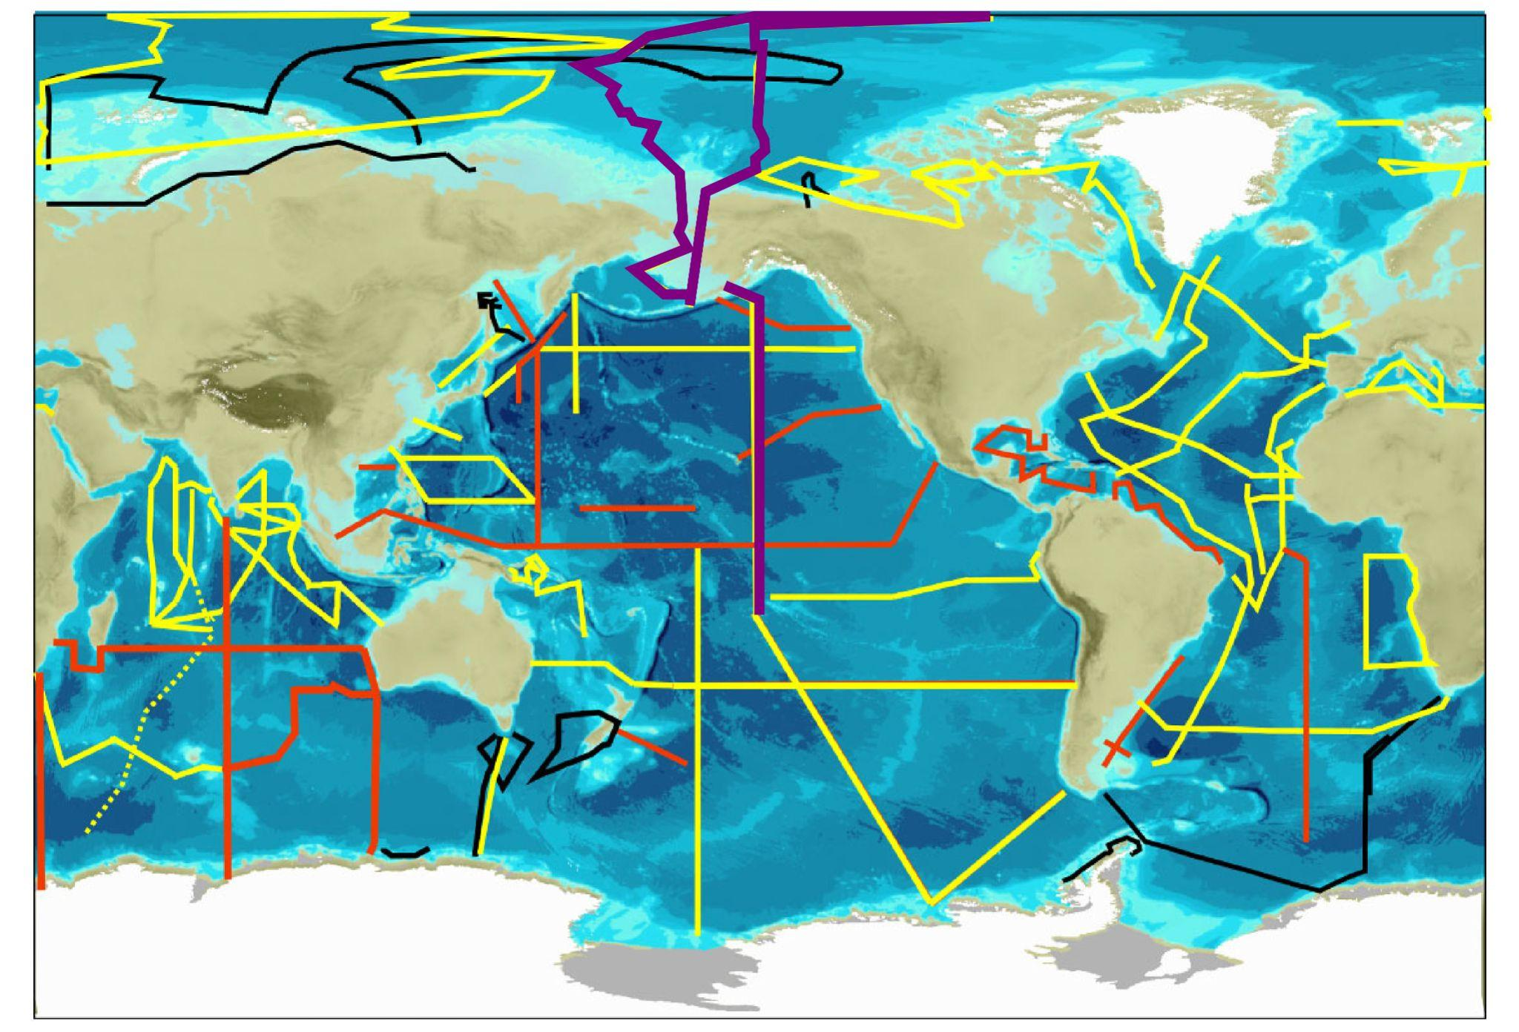
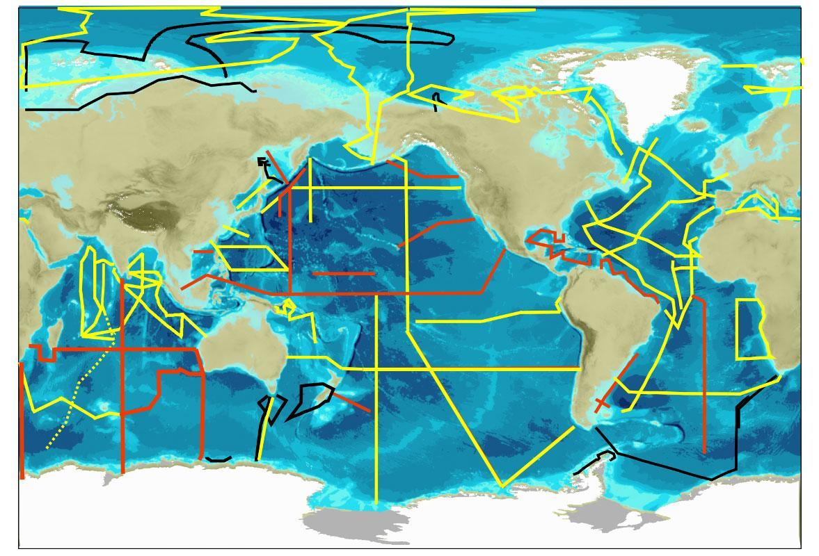
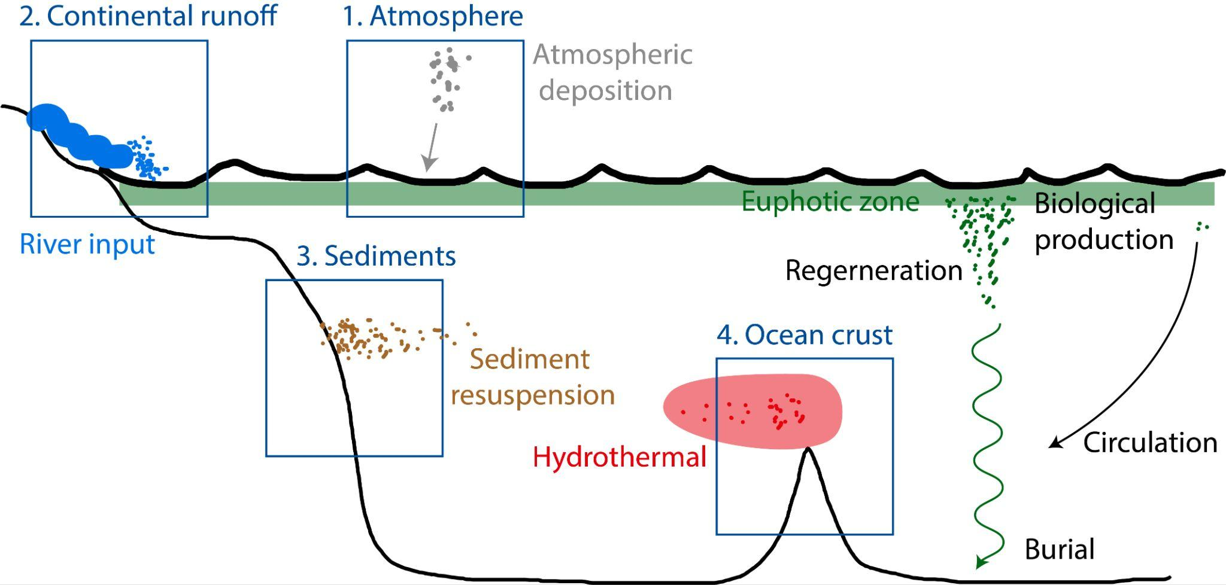

Yang Xiang (he/him)
UW CICOES Postdoctoral Fellow
yaxiang@uw.edu | @_oceanyang
PhD: UC Santa Cruz, 2021
GEOTRACES cruise tracks
Particle sources, sinks and internal cycling in the ocean

Slide 2
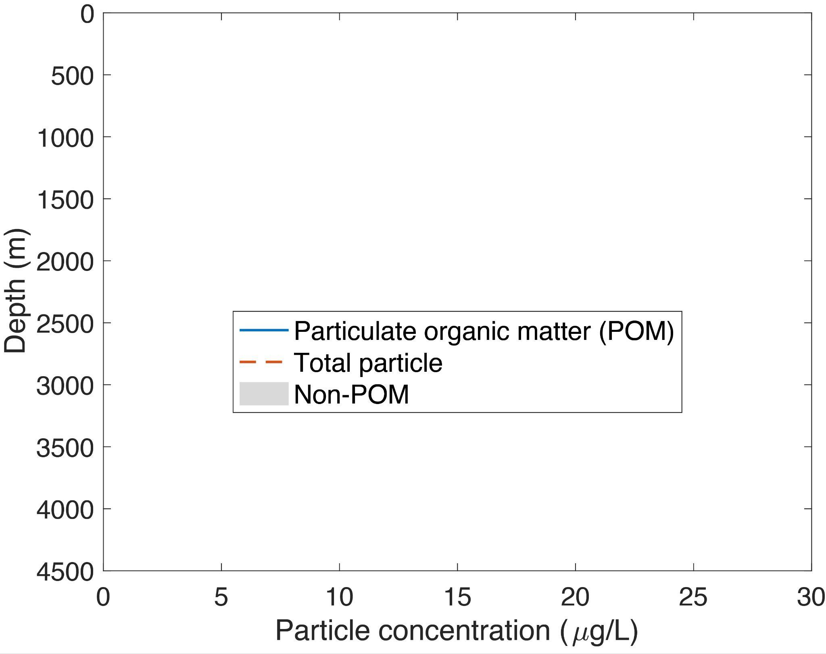
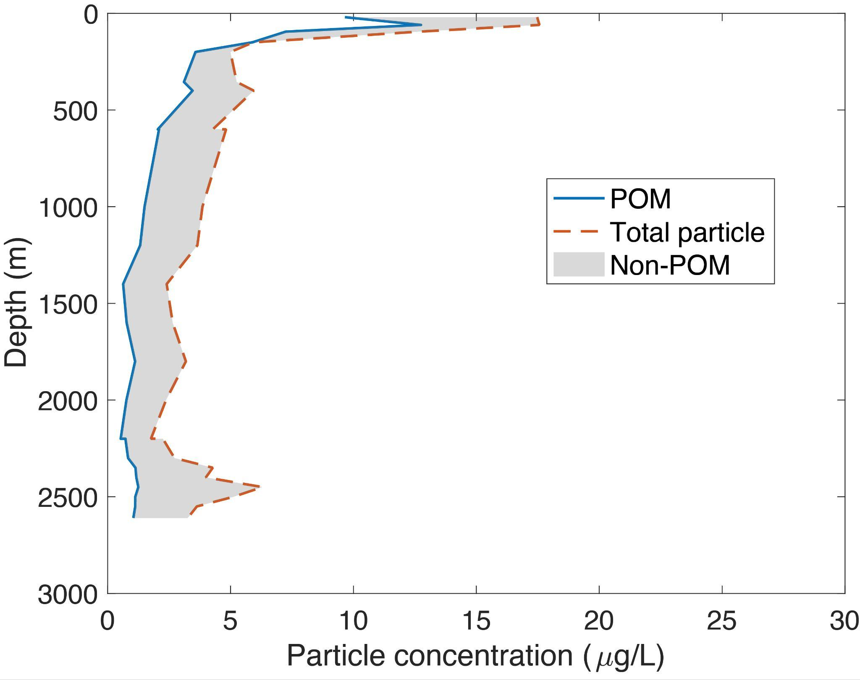
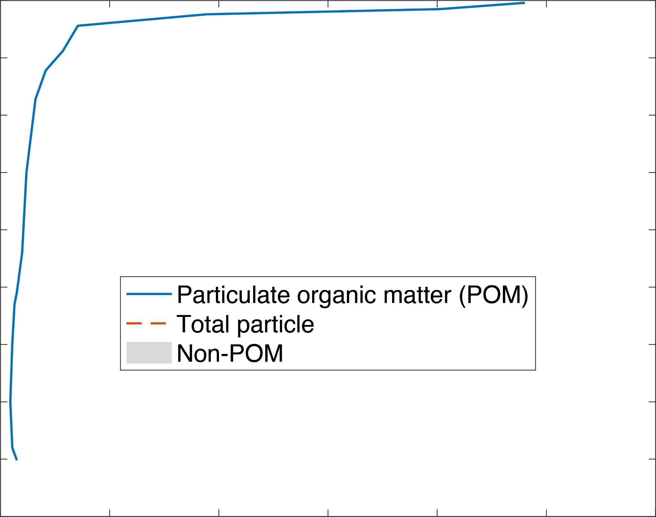
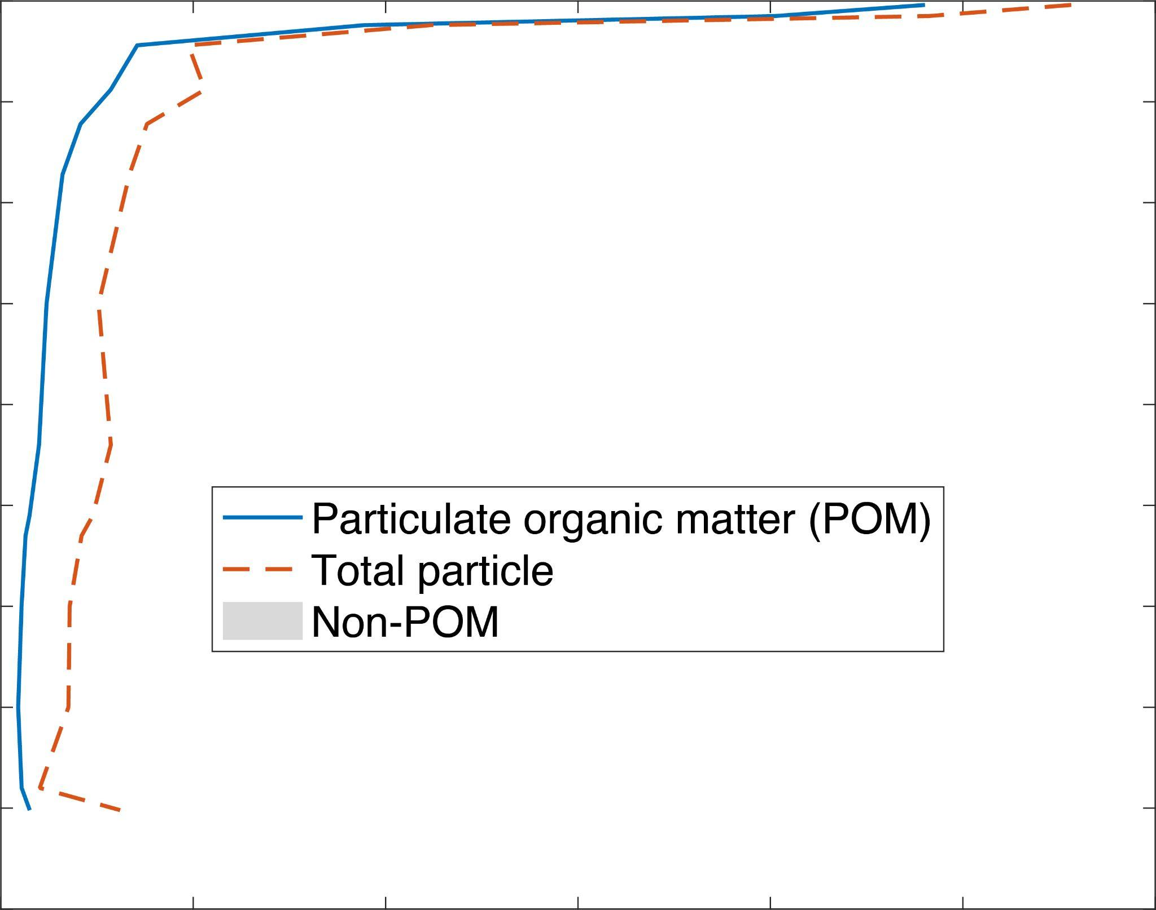
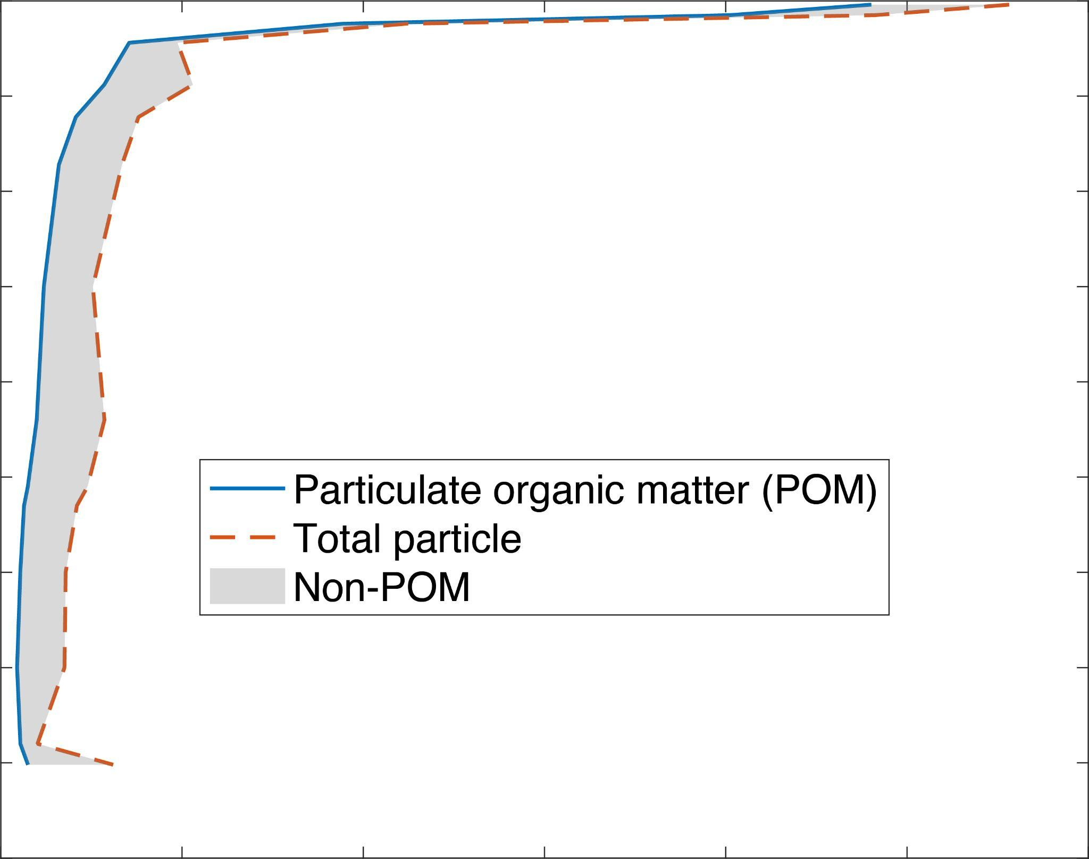
Particulate organic matter (POM) vs. Non-POM phases
Hydrothermal vent
Bottom sediment
resuspension

Slide 3
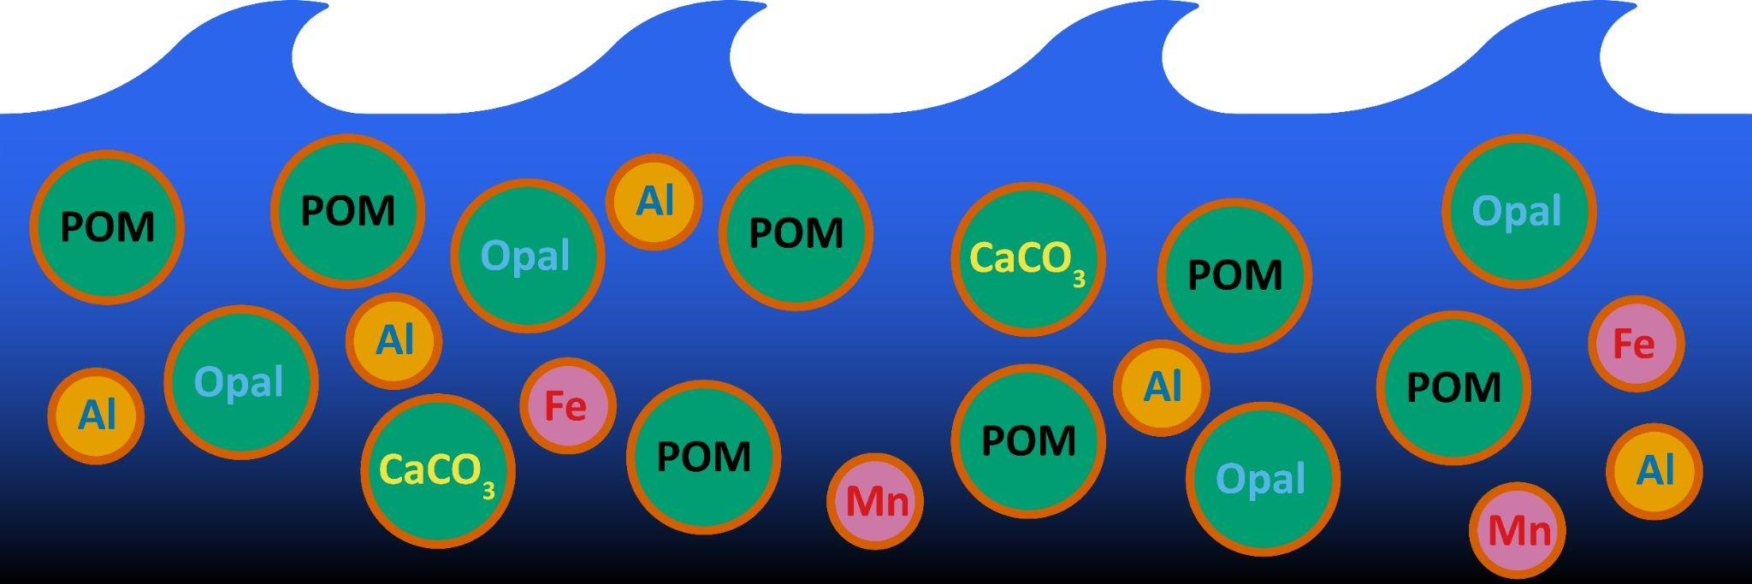
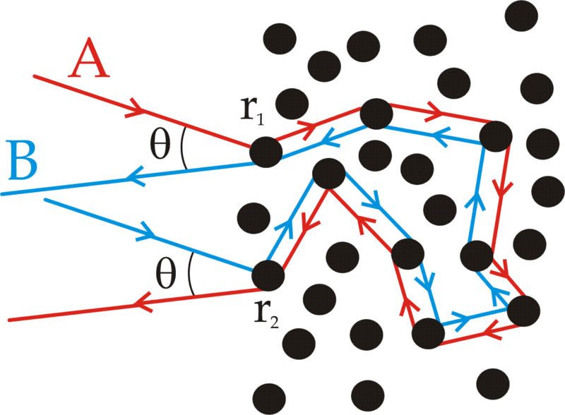
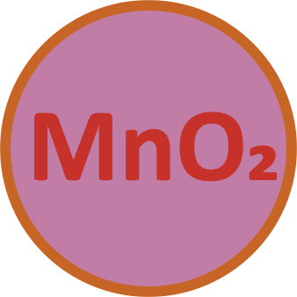

Research interests
Optics vs. particle composition
POM vs. non-POM phases: different refractive indices
Trace metal scavenging vs. particle composition
POM vs. non-POM phases: different scavenging intensity
Strength of the biological carbon pump vs. particle composition
The ballast effect and carbon flux
Elemental stoichiometry of POM (C/N/P ratios)
²³¹Pa
²³⁰Th
ballast
yaxiang@uw.edu

