Slide 1
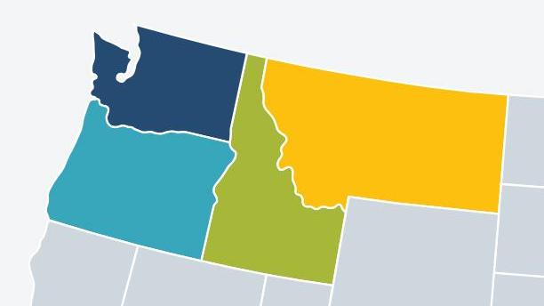
Visualizing the Clean Energy Transition in the Northwest
Leslie Nguyen and Cassidy Quigley
A PCC ACORN partnership with the Clean Energy Transition Institute (CETI)

Slide 2

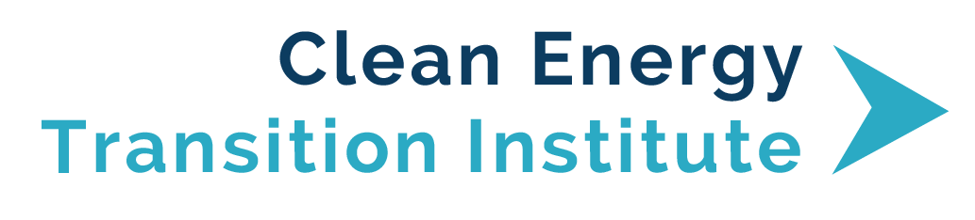

Modeled after the American Geophysical Union’s Thriving Earth Exchange
Connects UW graduate students and postdocs with community groups
CETI is a nonprofit providing independent, nonpartisan research and analysis in the Northwest
  WA, OR, ID, and MT
Mission: accelerate an equitable clean energy transition
Provide unbiased research and analytics
Expand student
networks, training,
opportunities,
& experiences
Address community
climate- & energy- related priorities
www.pcc.uw.edu/research/acorn-program/
www.cleanenergytransition.org/
Notes:
Transition:
First show ACORN - What is ACORN?
Next show CETI - Who is CETI?
mention Eileen is attending and will be available for questions afterwards

Slide 3
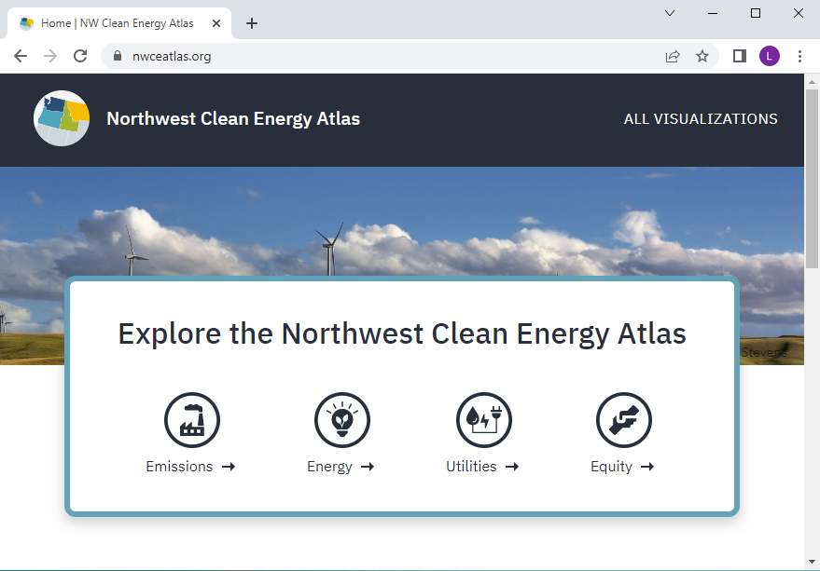
Northwest Clean Energy Atlas
An interactive dashboard for data and analysis, examining energy, emissions, utilities, and other data relevant to decarbonization in the Northwest.
Notes:
Describe concept behind the atlas, describe timeline of ACORN’s involvement
From CETI’s website: “The Institute’s Northwest Clean Energy Atlas project uses Tableau’s data visualization software to create an interactive atlas exploring energy data relevant to deep decarbonization in the Northwest”
Uses tableau to create an interactive atlas exploring energy data relevant to deep decarbonization in the Northwest.

Slide 4
Northwest Clean Energy Atlas
An interactive dashboard for data and analysis, examining energy, emissions, utilities, and other data relevant to decarbonization in the Northwest.
Research & Development of New Visualizations
ACORN Onboarding
Atlas Launched
April 2022
August 2022
February 2023
February 2022
May 2022
September 2022 - January 2023
Atlas Beta Testing
Updated Visualizations
Net-Zero Northwest
Notes:
Describe concept behind the atlas, describe timeline of ACORN’s involvement
From CETI’s website: “The Institute’s Northwest Clean Energy Atlas project uses Tableau’s data visualization software to create an interactive atlas exploring energy data relevant to deep decarbonization in the Northwest”
Datasets were typically updated yearly. We helped test the atlas, update visuals when new data was available, and brainstorm new visualizations
We were onboarded in February of 2022. Then we helped beta test the atlas and provided feedback on visualizations and explanations.
From May to August we updated Atlas visualizations with latest data and documented process for future updates, including Tableau tips and tricks.
Through the fall we researched new visualizations
In Feb 2023: Helped with the new upcoming project Net-Zero Northwest. Reviewed preliminary results with CETI and provided feedback on data presentation and potential visualizations

Slide 5

Notes:
We will start on the front page of the altas at nwceatlas.org. There are vizualizations for Emissions, Energy, Utilities, and Equity
Looking at energy, all the visualizations work together to inform the user, for time we will jump to energy generation
[Talk through info on generation paragraphs]
These blue dots are hydroelectric power, largest being grand coulee and more dams are shown along the columbia river
If we are interested in high emissions energy sources we can select them to see where they are generated. We can do the same thing with renewables like solar and wind.
There are also visualizations for utilities, we will look at natural gas. This visualization shows what areas utilities serve, the number of customers, and the utility revenue.

Slide 6
Notes:
Screen caps of click through / describe up to two visualizations each?

Slide 7
Reflections
As an ACORN project:
Applied existing skills in a new context
Learned new skills and explored new research areas
Real-world example of climate-related research product
Communicating complex data to help people understand decarbonization pathways
Enjoyed working with an organization whose mission aligns with our interests
Notes:
As an acorn project - hit major goals of ACORN by providing opportunity outside of academia, built new skills, real-world application of…
Translating data into visualizations was an exercise in how to communicate complex data to help people…
CETI appreciated flexibility of working with grad students through ACORN

Slide 8
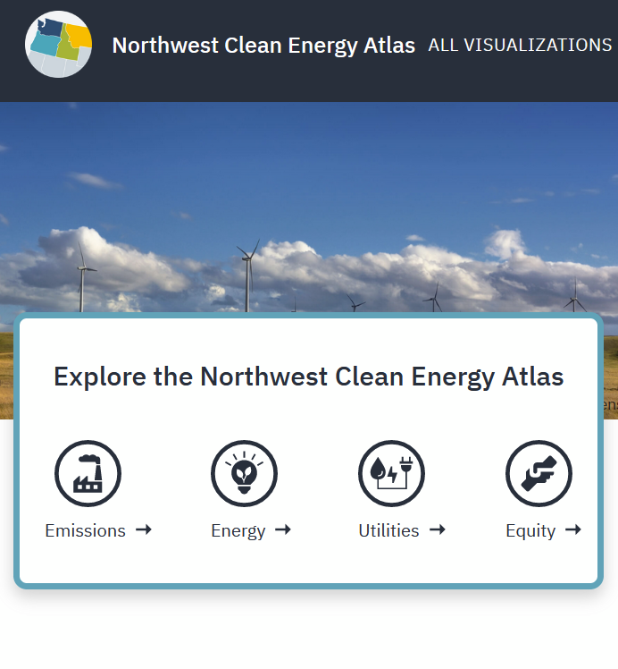
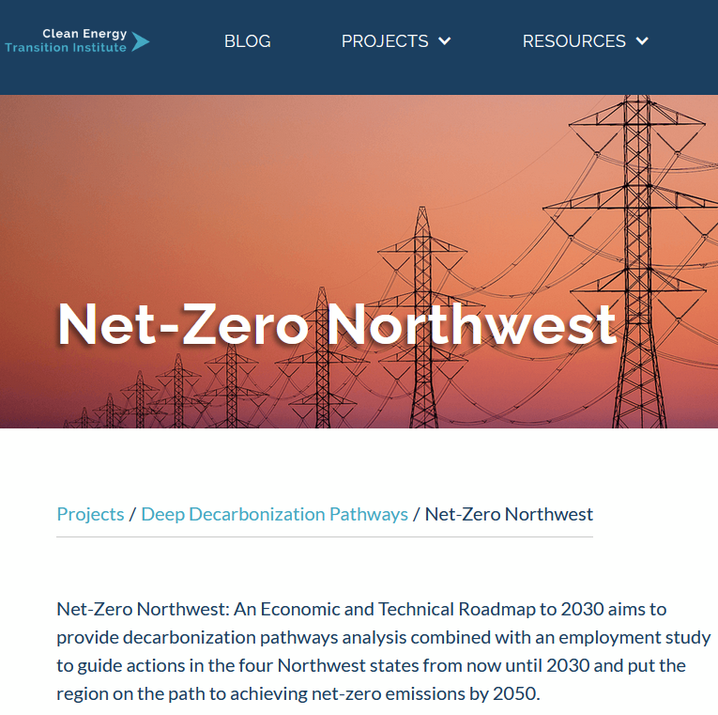
Acknowledgements
Thank you to CETI and the PCC ACORN program for providing this opportunity.
A big thank you to our other collaborators on this project:
Jade Sauvé (UW)
Jacob Cohen (UW)
Ruby Moore-Bloom (CETI)
Eileen V. Quigley (CETI)
[launching soon] www.netzeronw.org
Potential for new ACORN volunteers to develop visualizations of Net-Zero Northwest modeling results.
www.nwceatlas.org
Potential for new ACORN volunteers to continue updating and creating new visualizations.
Notes:
Net zero northwest project - New report examining pathways to net-zero by 2050, integrating policy considerations like CETA in WA and IRA - new visualizations!

