Slide 1
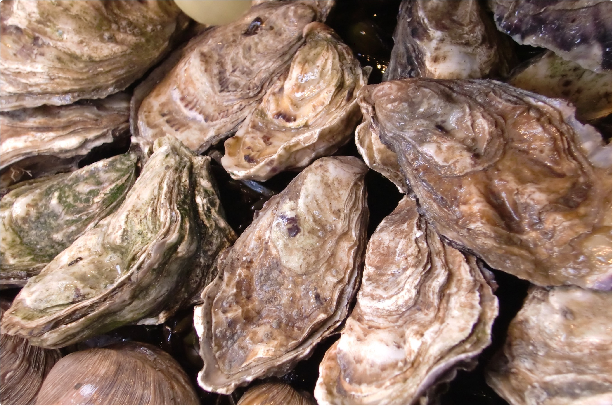



Climate change impacts on farmed Pacific oysters
CRAIG NORRIE - SAFS

Slide 2
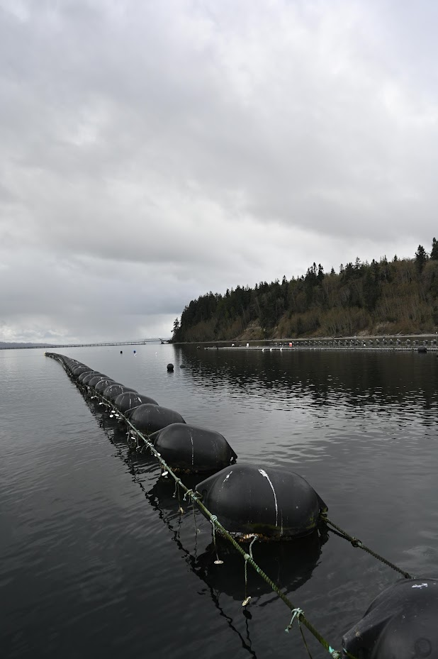
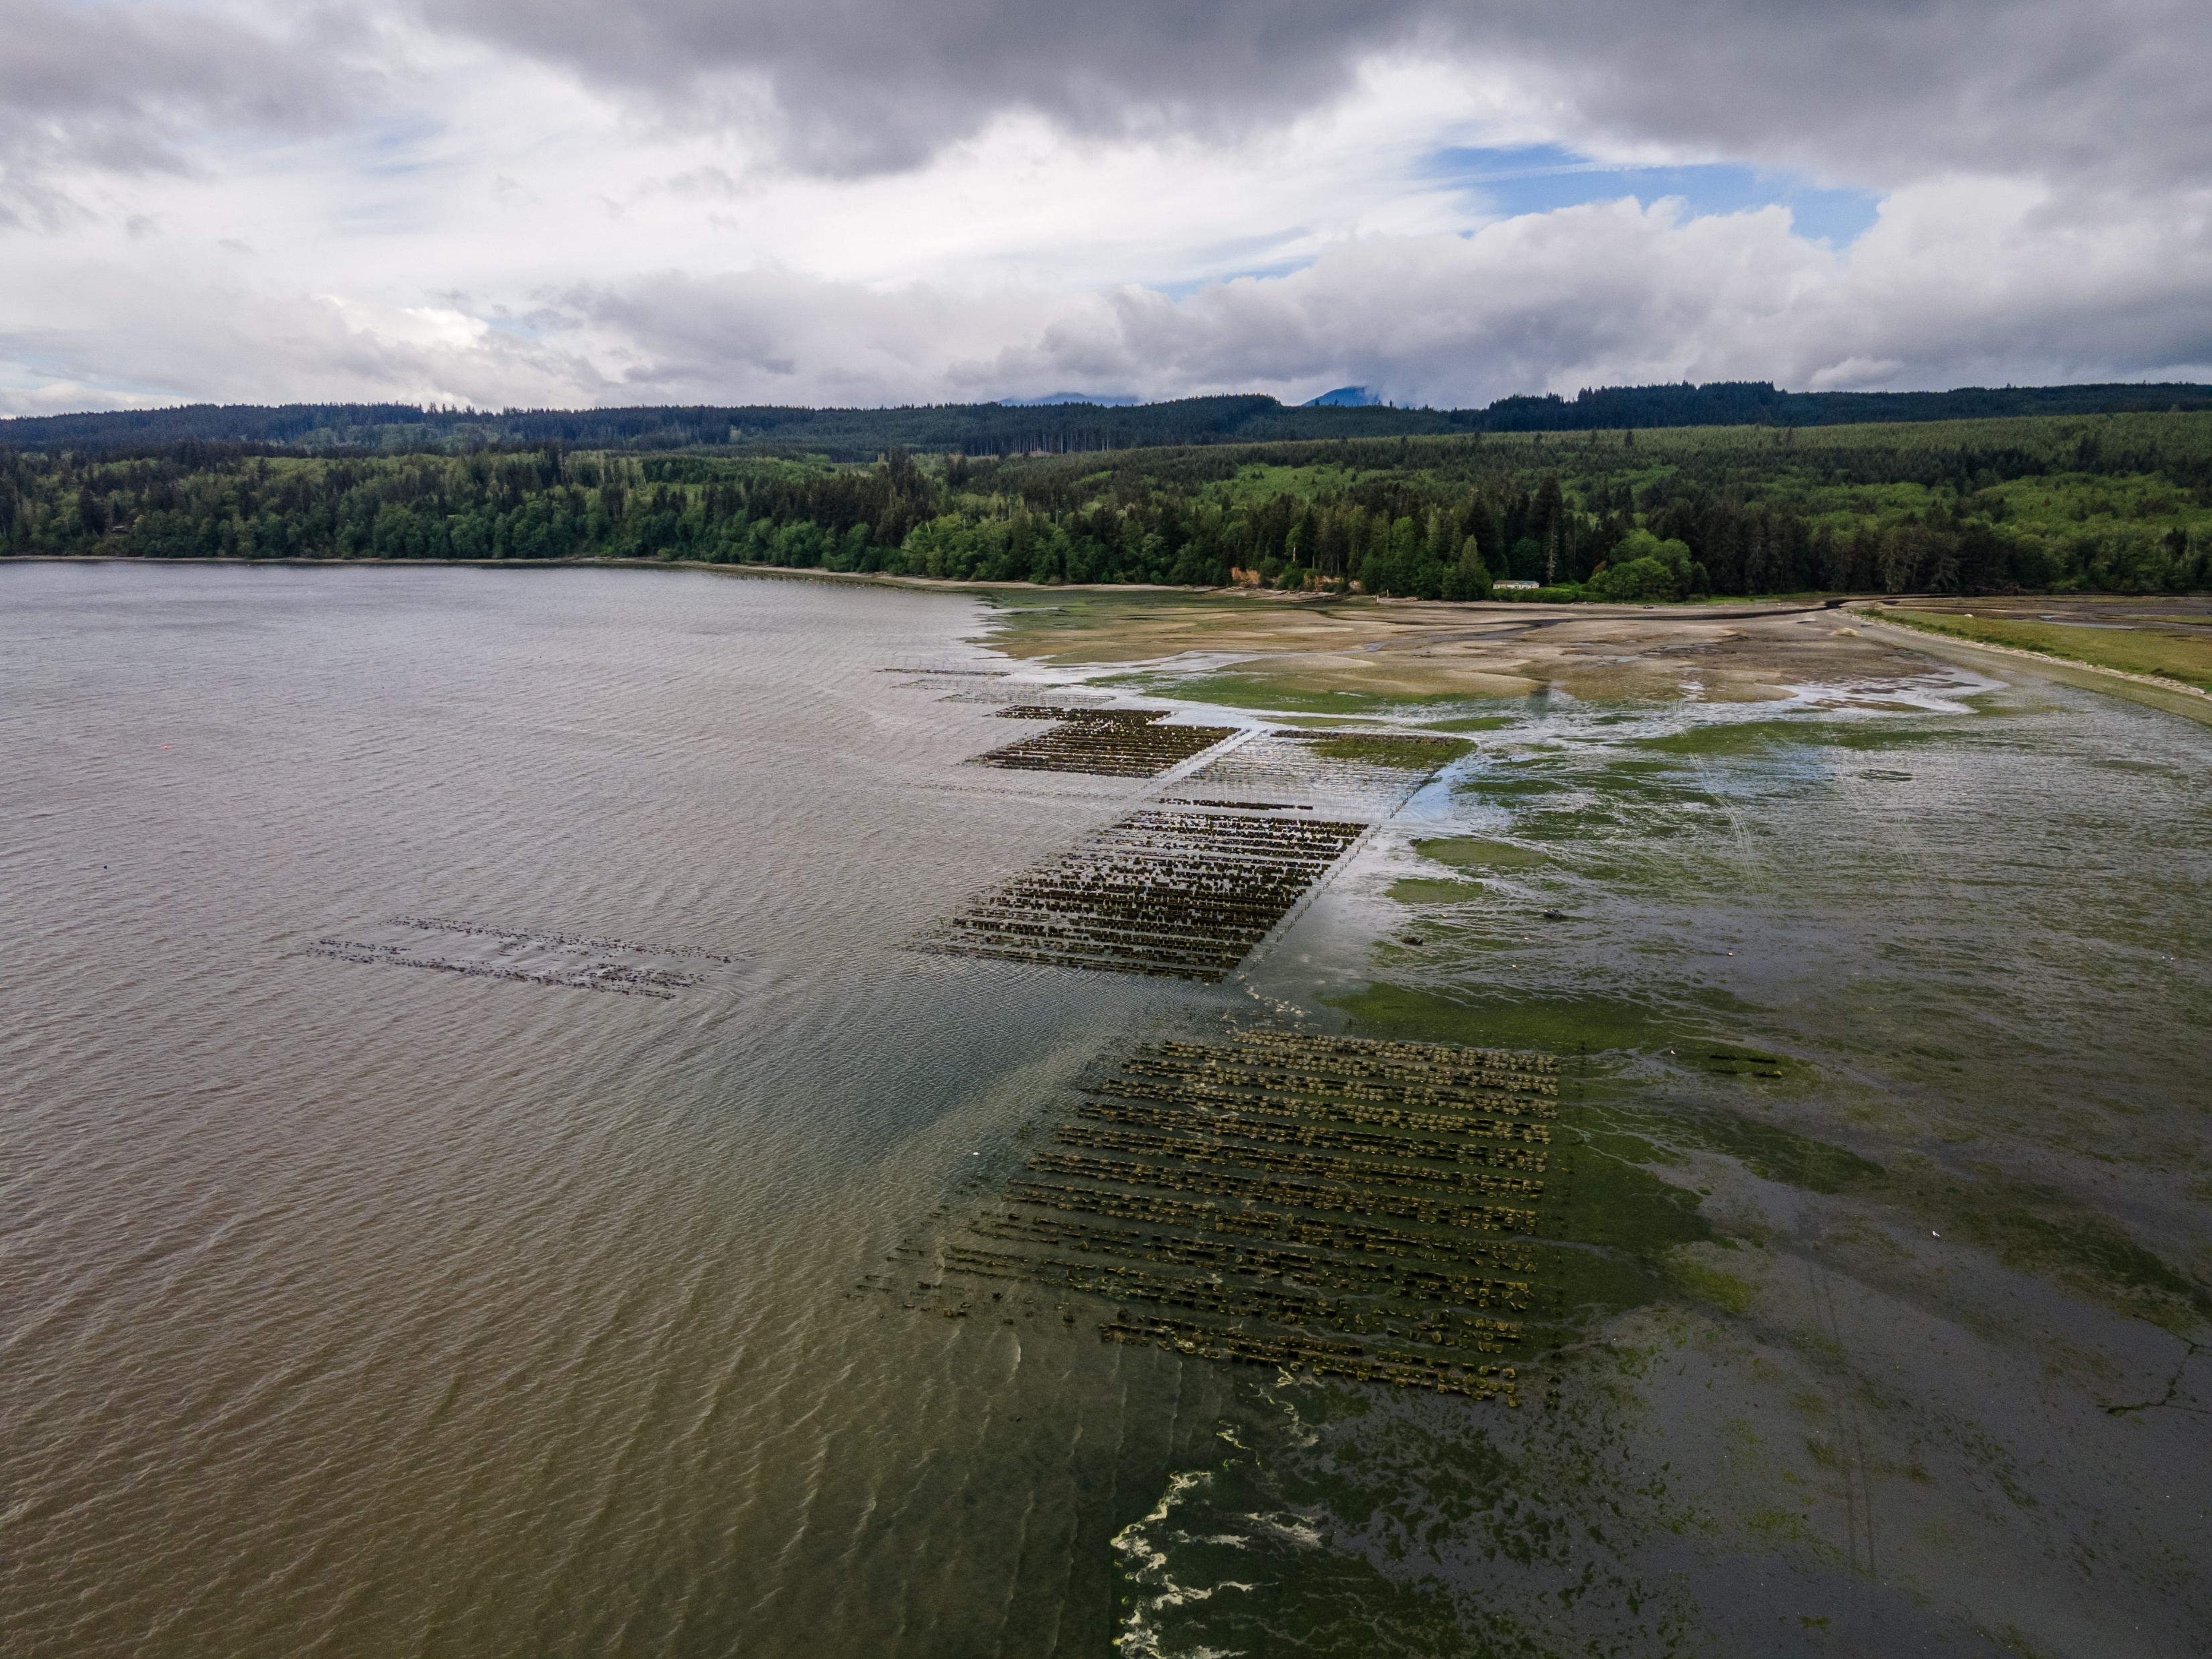
Washington oyster industry

Slide 3

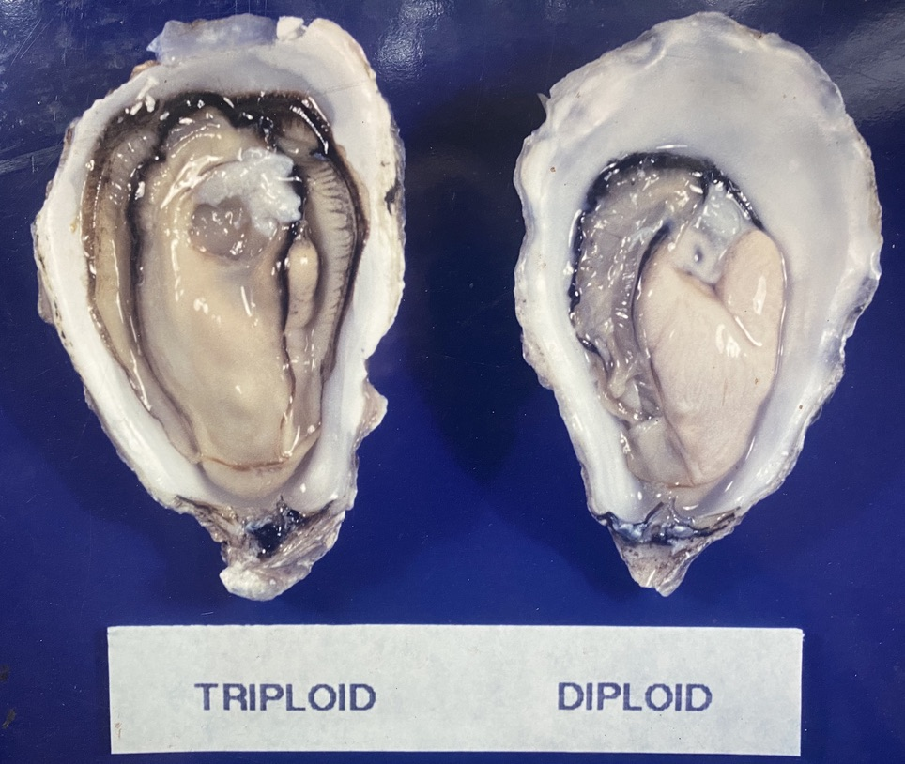
Diploid and triploid oysters

Slide 4
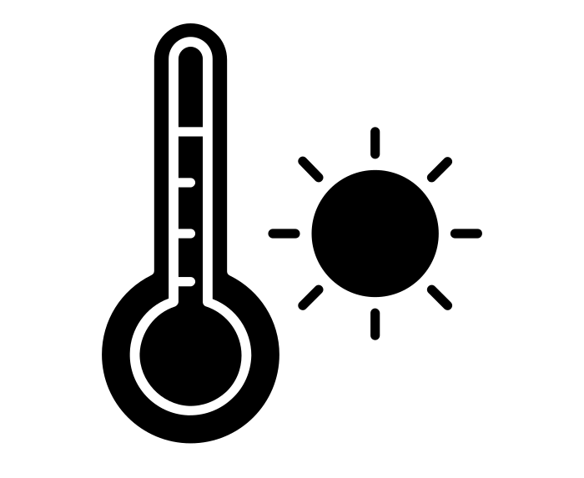

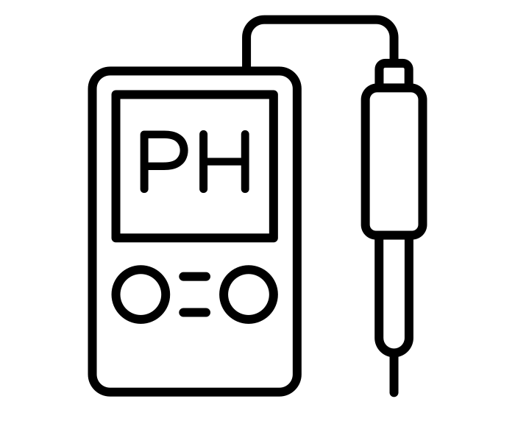
Interacting Physiological stressors
X/+/-
X/+/-
Temperature
Dissolved oxygen
pH/Ocean acidification
Notes:
Talk about why these stressors
Primarily factors that will be exacerbated by climate change
We are aware that there are others such as vibrio infection etc.

Slide 5
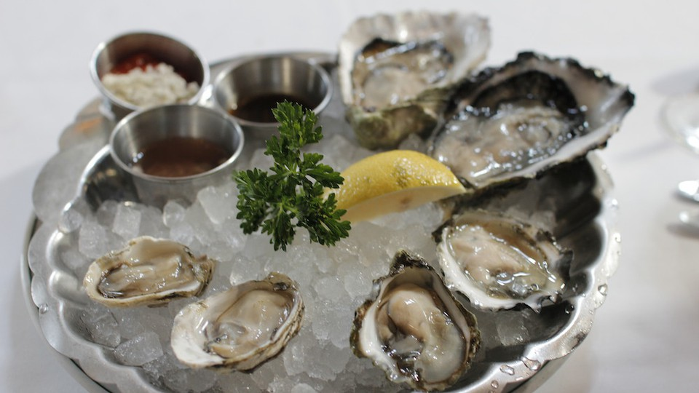
Thank you!

