Slide 1
THE HEAT IS ON: IMPROVING EXTREME HEAT EVENT RESILIENCE IN WESTERN WASHINGTON’S HEALTHCARE COMMUNITY
Notes:
How many of you were here in late June of 2021? [Wait for hands]. Well, for those of you who weren’t– it was absolutely miserable. But what if I was to tell you that there’s a very real possibility that we’d experience crushing heat waves like that summer’s every 5 years? Are we ready for that future? In recognition of this threat, I’ll be talking about a joint project conducted by the school of public health and the northwest healthcare response network (or NWHRN) aimed at improving the capabilities of our region’s healthcare community to respond to extreme heat events (or EHE’s).

Slide 2
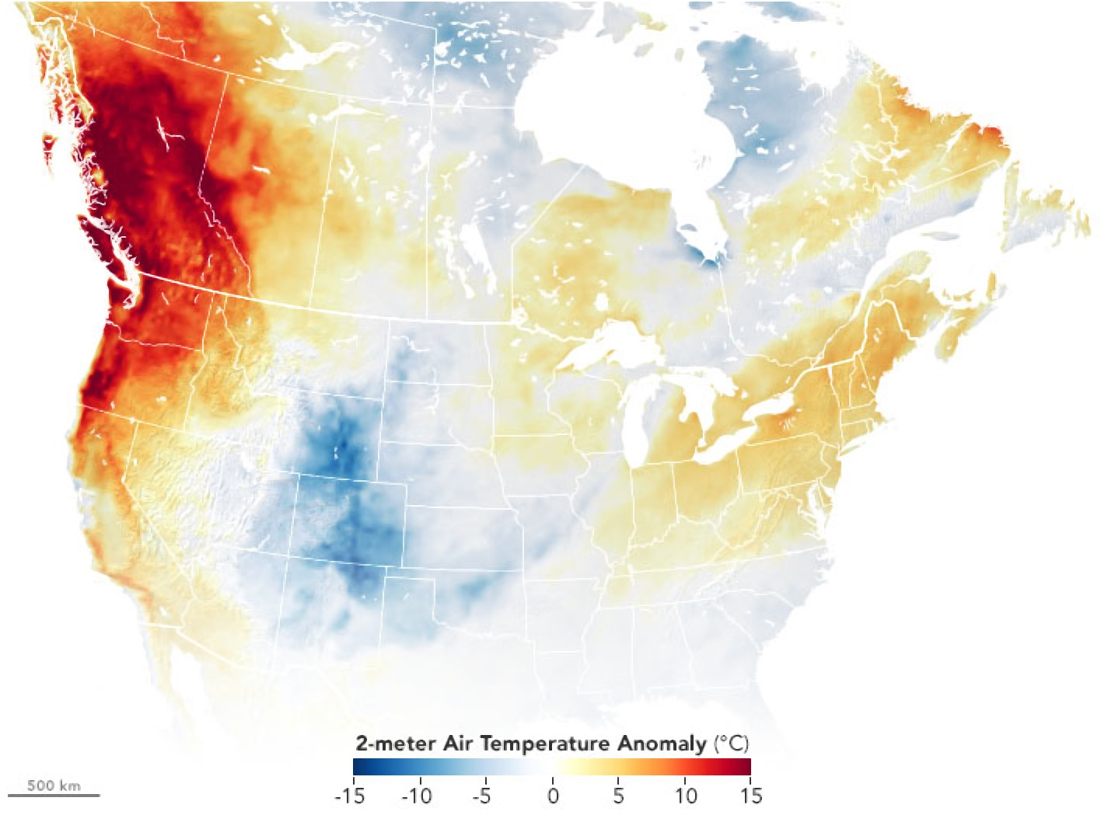
CONTEXT
2021 Extreme Heat Event (EHE): June 26 - July 2
Unprecedented in the region
Serious impacts on healthcare community
Northwest Healthcare Response Network (NWHRN) partners with UW
Notes:
Between June 26th and July 2nd, the Pacific Northwest experienced an unprecedented heat wave, with anomalous temperatures nearly 30F higher than their averages for that time of year. It was the longest, hottest, and deadliest weather event in Washington’s history. Temperatures peaked in the low 100s (though we set a new state record of 120 degrees!), and heat persisted well into the night. For context, in Seattle, we’d only experienced temperatures above 100 3 times since the 1890s. Because of our moderate temperatures, our region is both poorly acclimated to heat and lacks sufficient temperature control infrastructure (like HVAC) to deal with prolonged or intense heat.
While the causes of the 2021 EHE are quite complex, multiple studies have noted that it would be virtually impossible without climate change– up to 150 times more likely than without– and future events are increasingly likely.
The EHE had severe impacts on our communities– particularly vulnerable subpopulations like the isolated elderly, our unhoused neighbors, and medically fragile individuals. These impacts and the potential future risk motivated NWHRN to partner with the University of Washington to identify areas to improve in future EHEs.

Slide 3
EHE IMPACTS
HOW DO WE MEASURE THEM?
In Washington: at least 100 heat-related deaths
~450 excess deaths reported
In the region, 69x increase in heat-related ED visits vs 2019
What made the event so impactful?
Event novelty and duration
Heat intensity and persistence
COVID-19
Notes:
The 2021 EHE led to a surge of heat-related illnesses that severely stressed emergency departments across western washington. Washington’s Department of Health reports at least 100 heat-related deaths, though looking at the 450 excess deaths during this time period (even including the impacts of COVID), the impact of the heat wave may be even greater– especially given that we typically expect 0 or single digit heat deaths.
While there are many complicated drivers of the surge, they can be broadly boiled down into the novelty and duration of the EHE, the intensity and persistence of the heat, and the copresence of the COVID-19 pandemic.

Slide 4
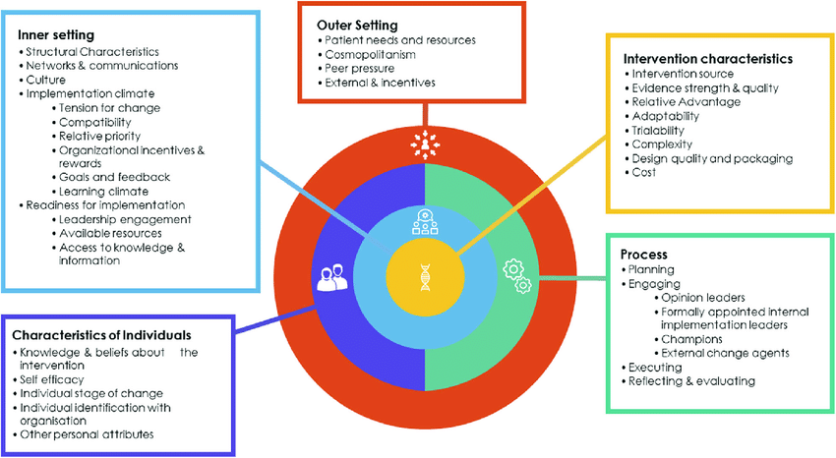
METHODS
Four regional listening sessions (n=109) > seven sector-specific focus groups (n=27).
Hospital administrators, emergency managers, public health professionals, patient-facing service providers, and other healthcare organizations.
Consolidated Framework for Implementation Research (CFIR) used for facilitation and coding
Qualitative data thematically analyzed.
Notes:
Our research team engaged NWHRN’s partners across a variety of healthcare sectors– including administration, clinical services, public health, emergency management, and hospice care, to name a few– in four regional listening sessions. We had impressive engagement during these sessions, so we then conducted seven follow-up focus groups to better probe themes we heard in the listening sessions. Our team then conducted a thematic analysis of the transcripts.

Slide 5
HEAT-RELATED CHALLENGES
Direct impacts on public, healthcare workers, and built environment
Gaps in infrastructure, supplies, and knowledge
Limits available interventions
Staff shortages and reduced capacity
Hard to provide quality care
COVID-19 constraints
Notes:
We heard from our participants that the heat caused heat related illnesses, stressed healthcare workers, and led to infrastructure failures like brownouts. The lack of regional preparedness led to limits on available response actions; many organizations reported a lack of supportive infrastructure, adequate supplies, and specialized knowledge. Staff shortages and diminished capacity– already heightened by the ongoing pandemic– made it difficult to provide quality care to a growing number of heat patients. Finally, the pandemic complicated response efforts, as some areas were already at capacity due to surging caseloads.

Slide 6
EFFECTIVE EHE RESPONSE
Activities supporting effective heat response:
Advanced planning
Internal and external communications
Leveraging partnerships for support
Opportunities for improvement:
Developing more robust evaluation processes
Improving regional coordination
Establishing or improving heat action plans
Notes:
Preparing for heat ahead of time due to advanced notification and early activation, having robust outreach to the public, staff, and partners, and using pre-existing relationships helped many healthcare organizations rise to the challenge, even with the aforementioned constraints. That being said, there is significant room to grow– particularly in our heat action planning, regional coordination, and post-event evaluation processes.

Slide 7

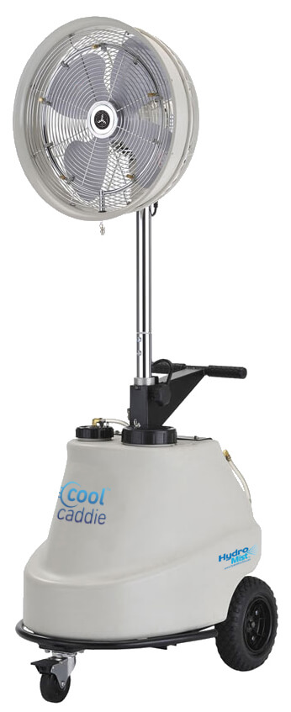

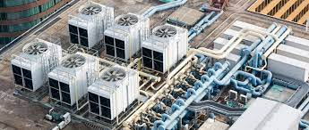
RESOURCES UTILIZED
HVAC and other cooling technology
Cooling centers
Low-cost personal cooling supplies
Information
Off-site storage
Notes:
Throughout the 2021 EHE, the healthcare community relied on HVAC and other cooling infrastructure (like heat pumps or swamp coolers), local cooling centers, low-cost personal cooling supplies (nearly everyone raved about the effectiveness of popsicles!, heat prevention information, and off-site cold storage to beat the heat. Building the regional levels of these key resources is critical for improving future response efforts.

Slide 8
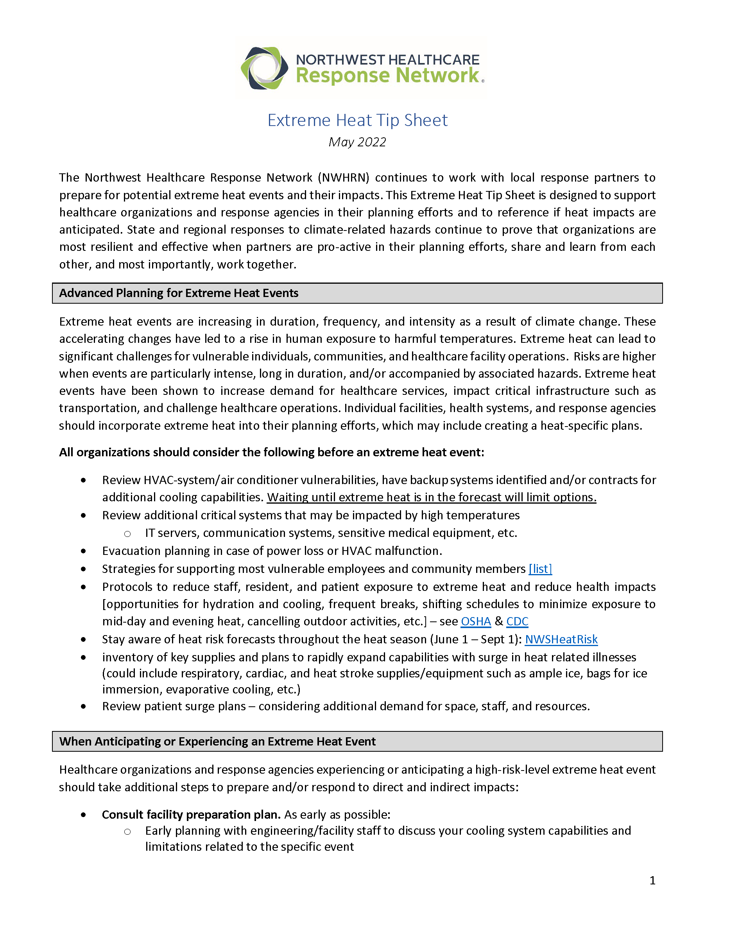
INTERCONNECTIONS
External partnerships
Peer organizations
Other healthcare sectors
Jurisdictional agencies
Private sector
Internal relationships
Public/community connections
Notes:
Interconnectedness

Slide 9
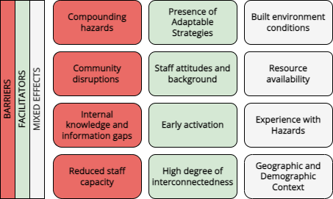
BARRIERS AND FACILITATORS
Ground conditions can modify heat response
Mixed effects vary based on local context, or are both barriers and facilitators
Notes:
I won’t get too much into the barriers and facilitators of effective response here, but the main takeaway is that local context really matters– there are few universal solutions given the wide variety of healthcare organizations, community needs, demographics and even geography. Everyone is stressed by extreme heat, but not in the same ways.

Slide 10
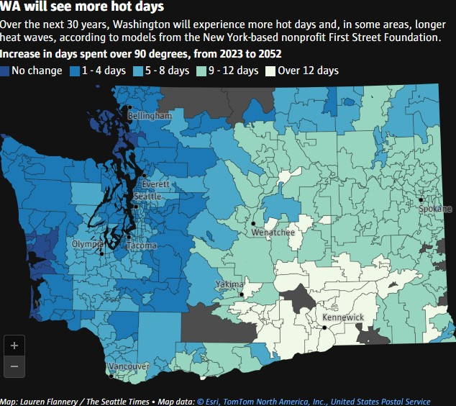
FUTURE NEEDS
Heat event planning
Community engagement
Regional coordination
Infrastructure improvements
Adapting strategies from other hazards
Reducing surge intensity
Improving staff capacity
Resource acquisition
Notes:
So to reiterate why this all matters– in the next 30 years, we’ll be seeing far more days spent over 90 degrees Fahrenheit, and with about 3 and a half degrees fahrenheit of global warming, our region could see events like the 2021 EHE every 5 to 10 years.
To prepare for this future, our region needs to improve its planning around heat events, incorporating them into the yearly planning cycle. We also need to improve community engagement to better tailor response activities, coordinate across organizations and jurisdictions, invest in infrastructure improvements, adapt strategies like telehealth from other hazards, target interventions at reducing surge intensity through preventative action, improve staff capacity across the healthcare community, and acquire stockpiles of key resources.

Slide 11
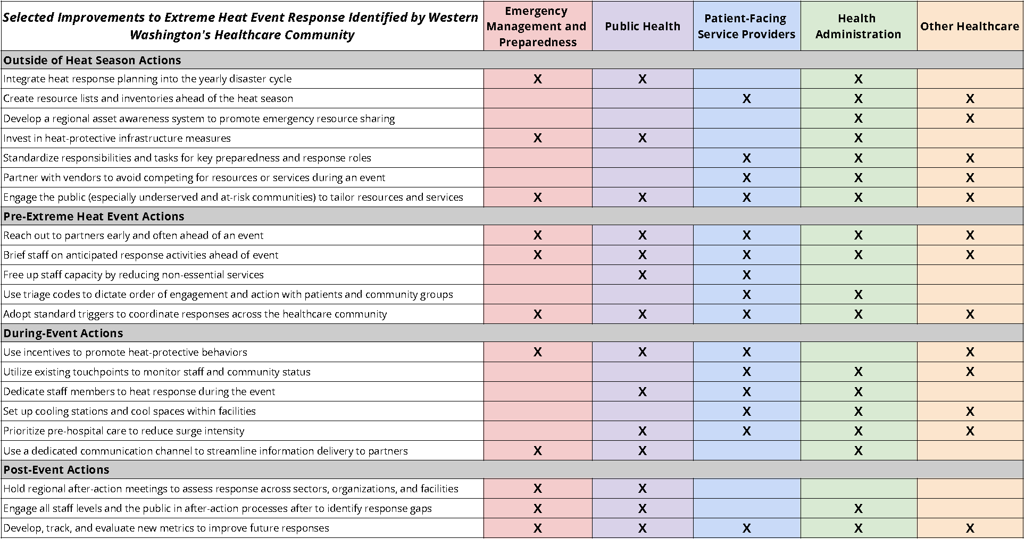
RECOMMENDATIONS
Notes:
We distilled actionable recommendations to address these needs into a table that NWHRN could share with its partners as a way to consider actions to take outside of the heat season, ahead of EHEs, throughout EHEs, and during the after-action evaluation process. Given the wide geographic and demographic variations in Washington, there are no one-size-fits-all solutions here– but hopefully, these will provide a starting point to improve regional coordination and capacity.

Slide 12
QUESTIONS?

