Slide 1
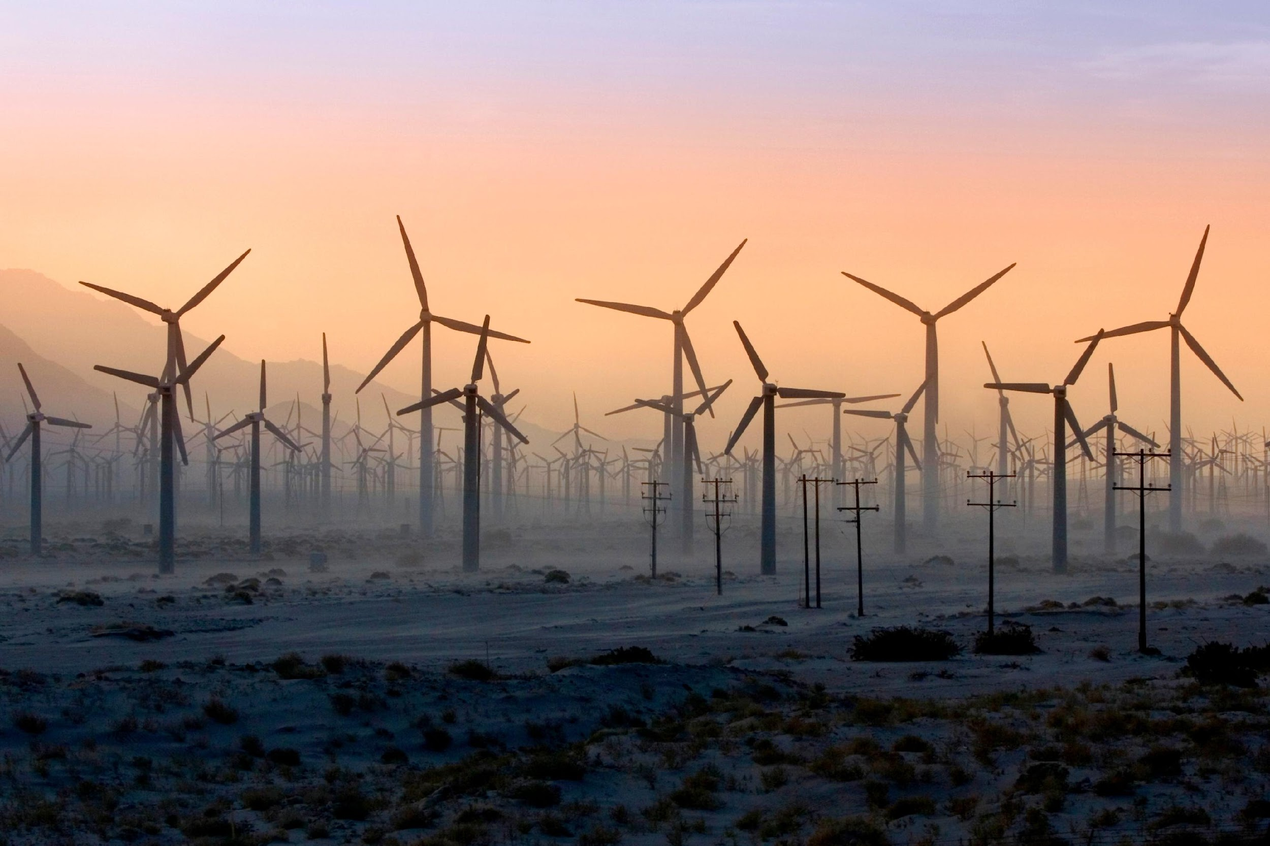
Are Wind Turbines the New Smokestacks?
Restrictive Renewable Energy Land-Use Ordinances Across U.S. Counties, 2010-2022
Inhwan Ko
University of Washington, Seattle

Slide 2
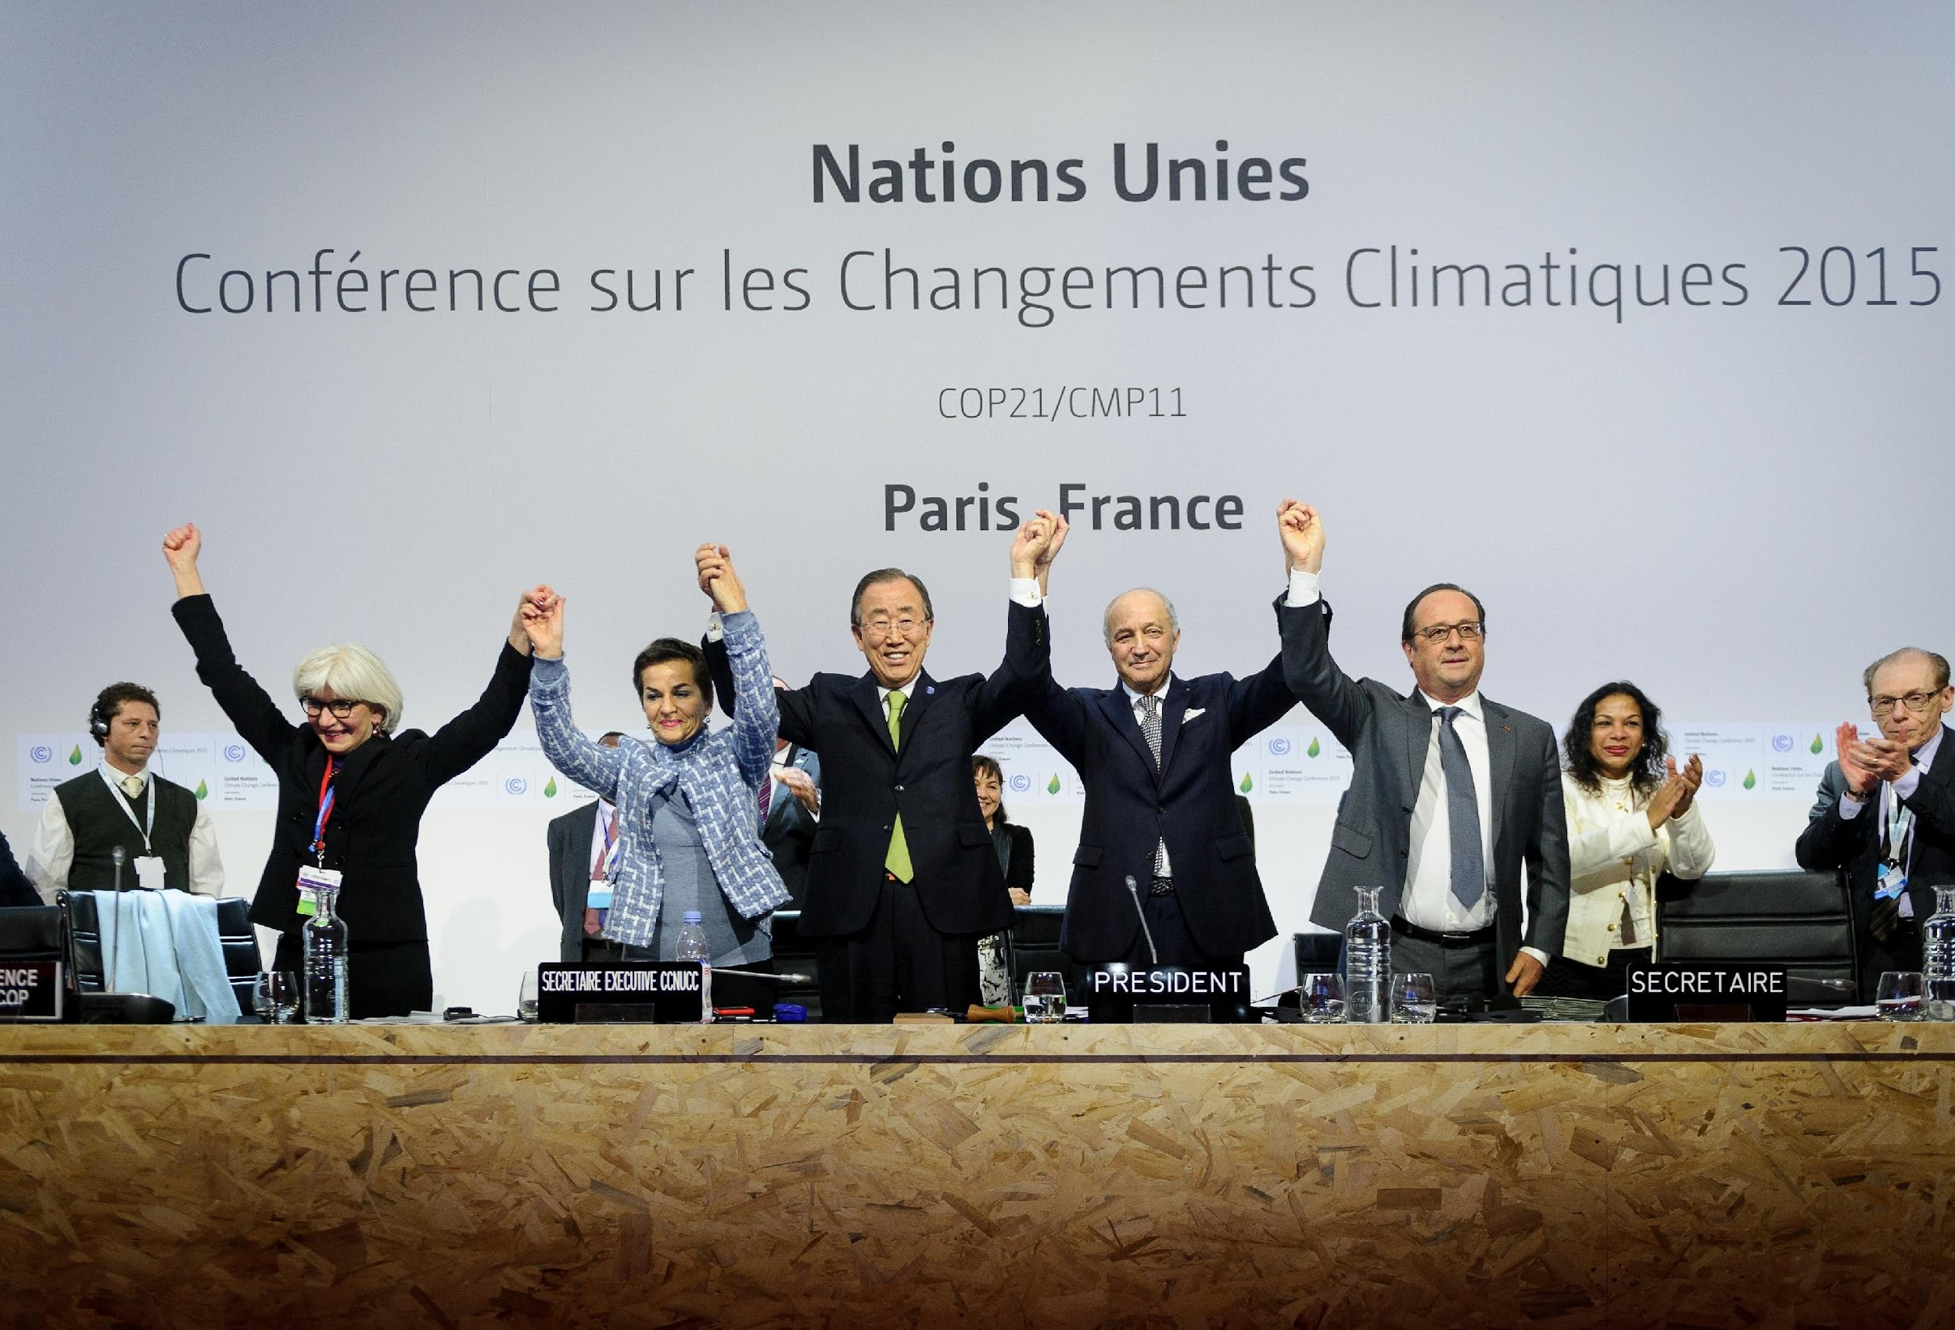
Net-zero emission is crucial for 1.5ºC (2ºC) pathways
Notes:
In 2015, Paris Agreement on Climate Change
net-zero emission goal by 2050
The goal is imperative

Slide 3
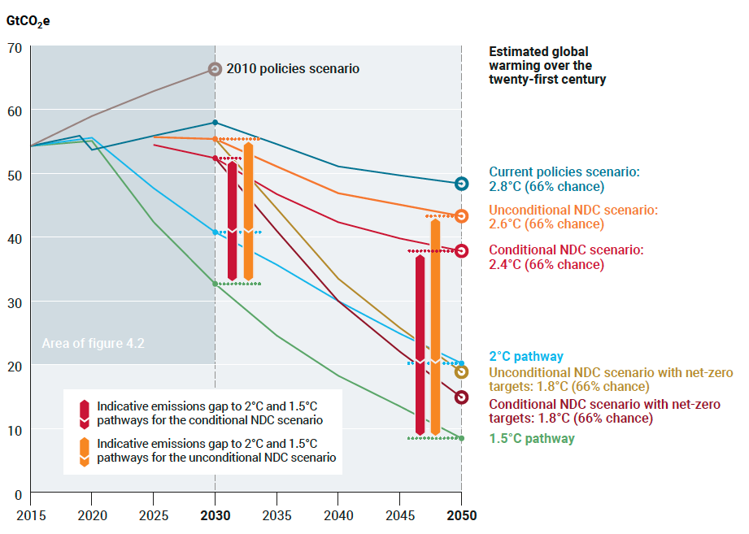
still fall short of what is needed for 1.5ºC (even 2ºC) pathways
Notes:
These commitments, however, still fall short
This figure is from
The red line
The blue line
There is a huge gap between what we will produce and what we must produce, therefore the report is called emissions gaps
This gap represents that NZE movement may be giving us a false hope for climate progress
Why are we seeing this gap

Slide 4
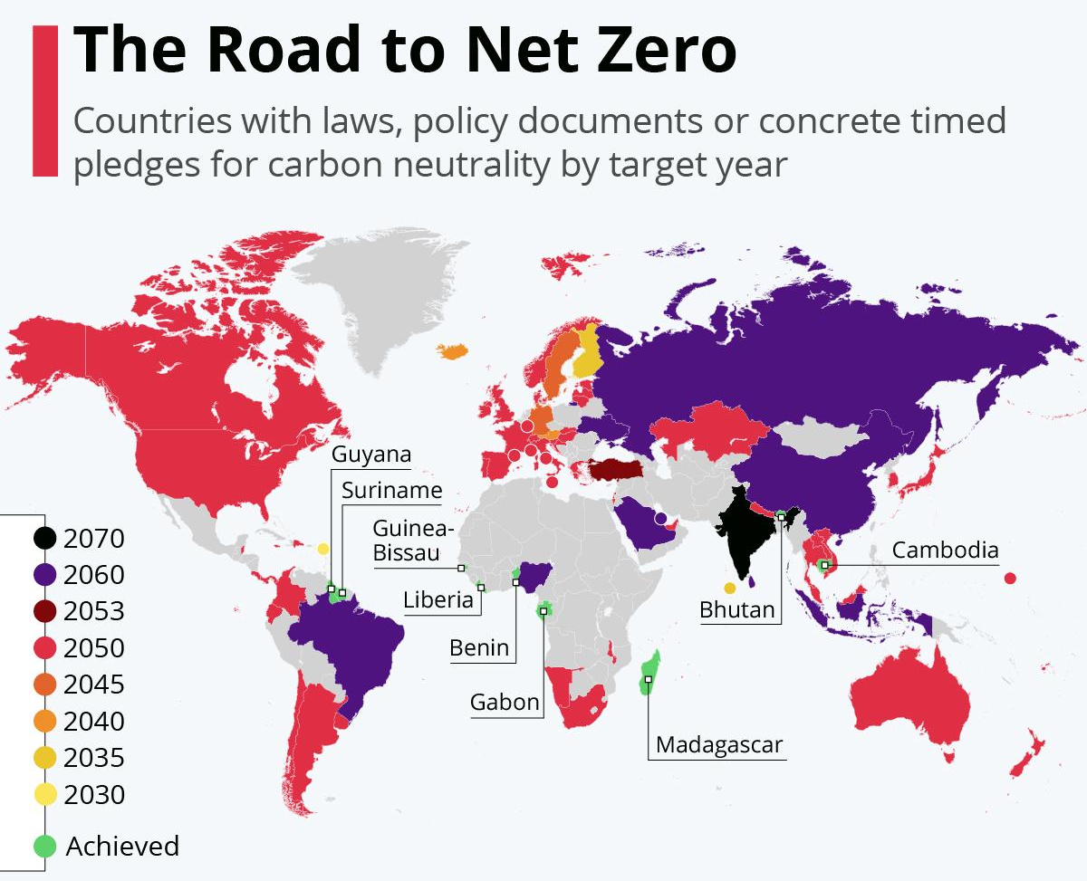
Because of varying target years and stringency
Notes:
An increasing number of
Ideally, countries should achieve NZEG by 2050
but countries have different target years

Slide 5
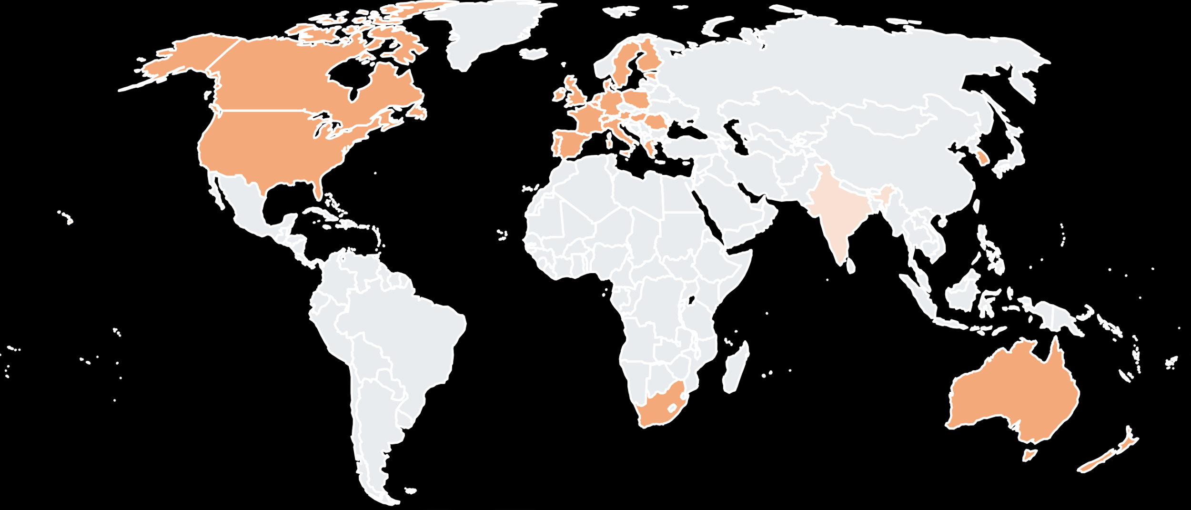
Local-level restrictions on RE facilities around the World
South Korea:
County-level wind restrictions: 50 / 226
County-level solar restrictions: 129 / 226
27 countries with local-level RE restrictions (including India which has a guideline)
Notes:
Second one
Even if countries wish to expand RE
they are facing local-level policy barriers like US
27 countries at least one
Heaviest polluters
Korea
where around 50 counties
and 1290

Slide 6
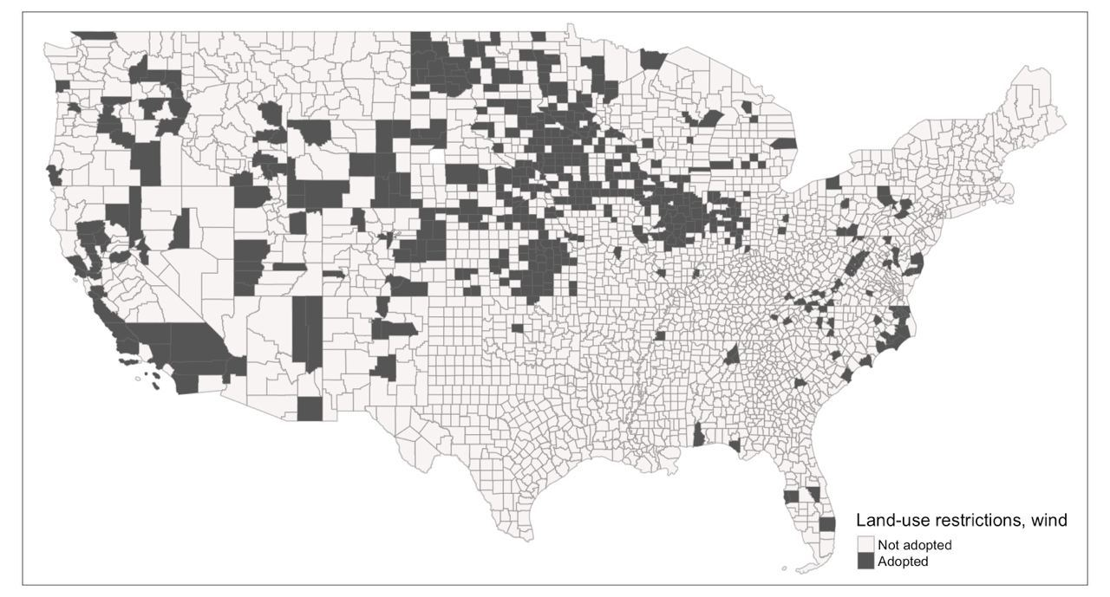
U.S. county-level restrictions on wind energy facilities, 2022
560 counties
Notes:
Here's the map of US counties with restrictions on wind

Slide 7
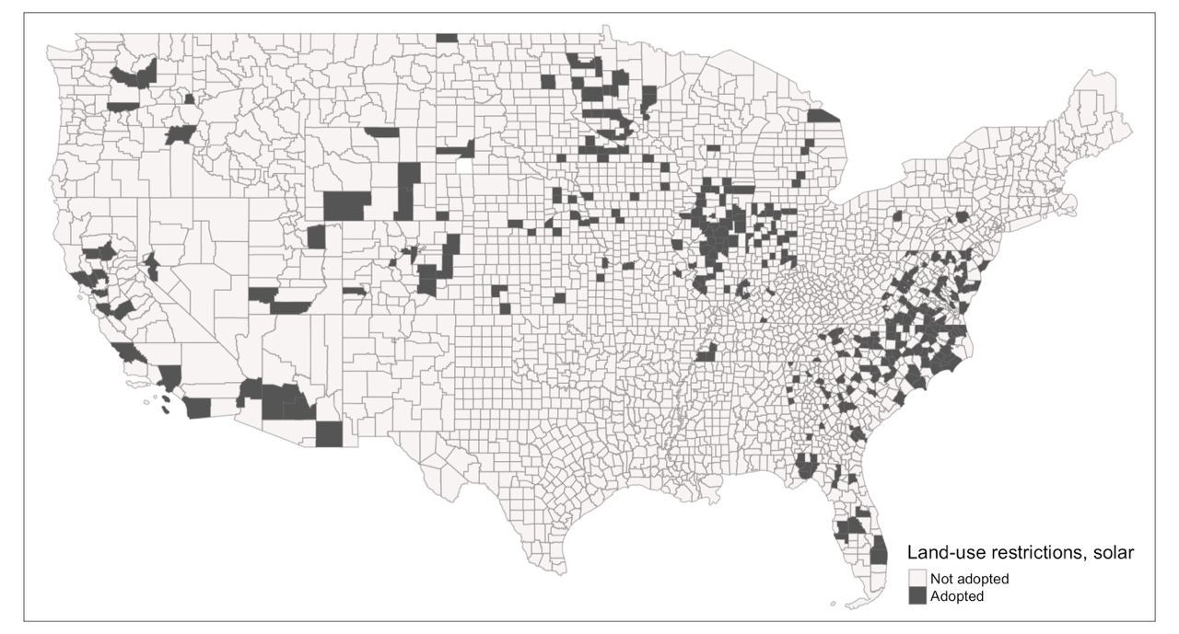
U.S. county-level restrictions on solar energy facilities, 2022
315 counties
Restrictions limit the available land for RE projects or delay their timelines
Notes:
Here's another map of counties with restrictions on solar
Let's look at the case of Nevada

Slide 8
Takeaway:
Countries must expand RE facilities to better contribute to 1.5C pathways.
But they also observe an increasing number of local governments adopting restrictions on RE facilities.
Why the restrictions?
Notes:
The takeaway is that
To help overcome the emissions gap globally,
countries should expand RE nationally,
To do so,
We need to understand why restrictions, subnationally
This is why I believe my research is about the interaction between global
What explains the onset of these restrictions

Slide 9
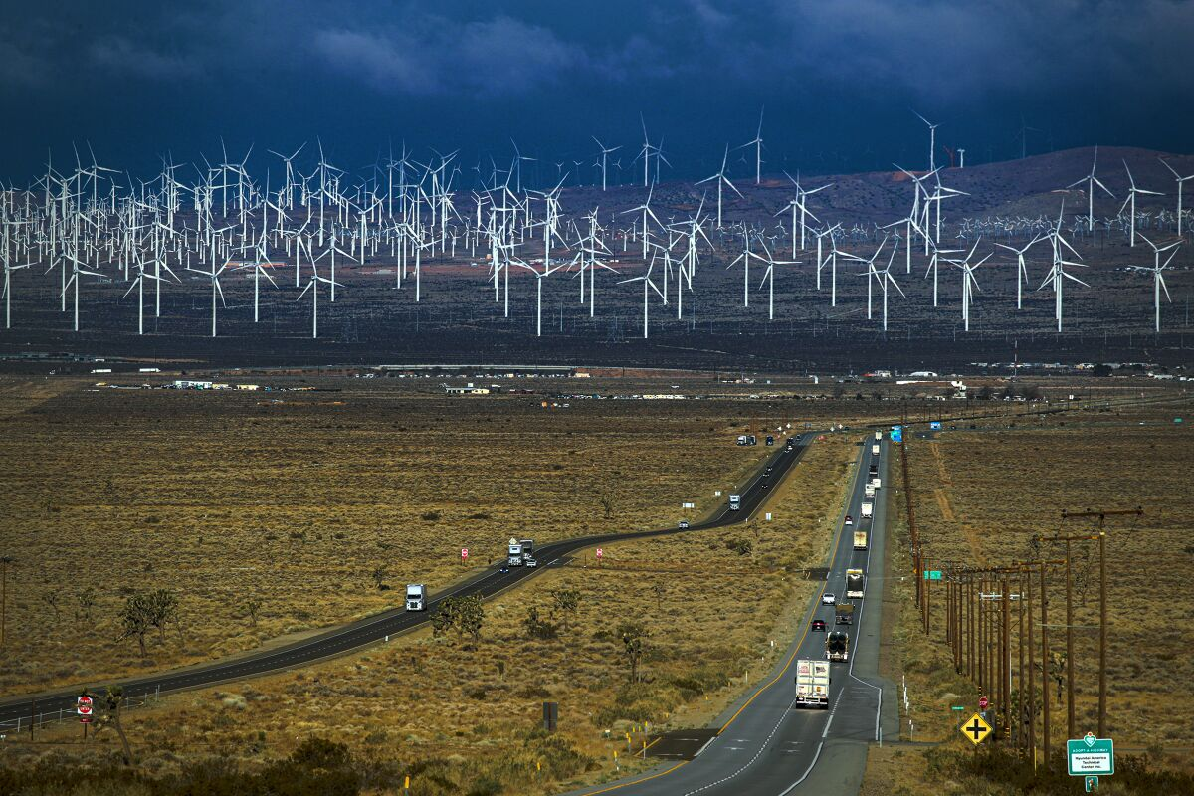
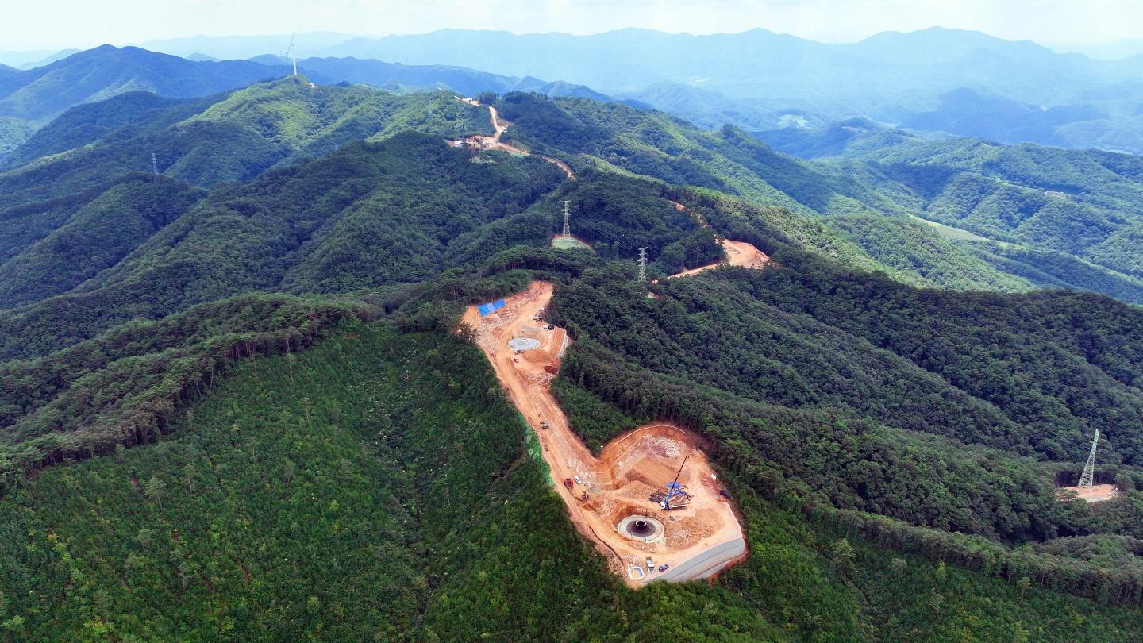
RE Facilities’ Impact on Rural Landscape
Notes:
Studies note that the most salient
Rural landscape
wind f and solar f are manufactured
Industrial transformation
During the planning process
replace
magnify

Slide 10
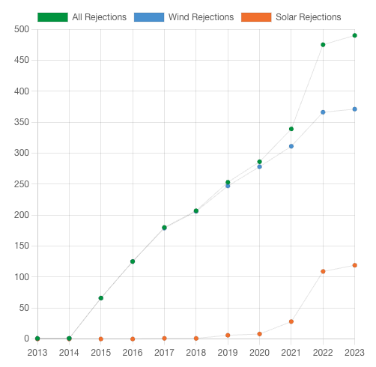
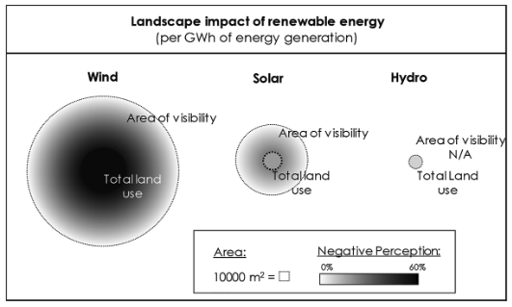
Wind vs Solar Energy Facilities in Problem Visibility
The level of problem visibility is higher for wind than solar energy facilities
Notes:
Okay, RE facilities disrupt landscape, so what does it tell us about restrictions?
Restrictions as policy responses
Public policy responds to more visually salient issues. Problem visibility matters
For instance
In the context of this research, wind and solar f may have different levels of problem visibility, facing different levesl of policy responsiveness
Conclusion:

Slide 11
Rurality matters for wind restrictions but not solar
Problem visibility influences public policy:
Wind energy facilities being new “smokestacks”
Rural RE opposition ≠ climate policy opposition
Reflects the desire to protect the integrity and quality of their landscape and rural life
“I’m not against renewable energy, I’m just against losing this beauty.”
- “Save Our Mesa” member, speaking of Battle Born Solar Project
Notes:
To explain how fast a policy responds to problems,
their visibility matters,
and because of this
wind energy facilities face earlier policy restrictions by rural counties.
Reflects the desire to protect the integrity
This is why many rural residents in South Korea are now protesting in national assembly and local governments,
proposing for more-landscape friendly RE projects, such as this one

