Slide 1
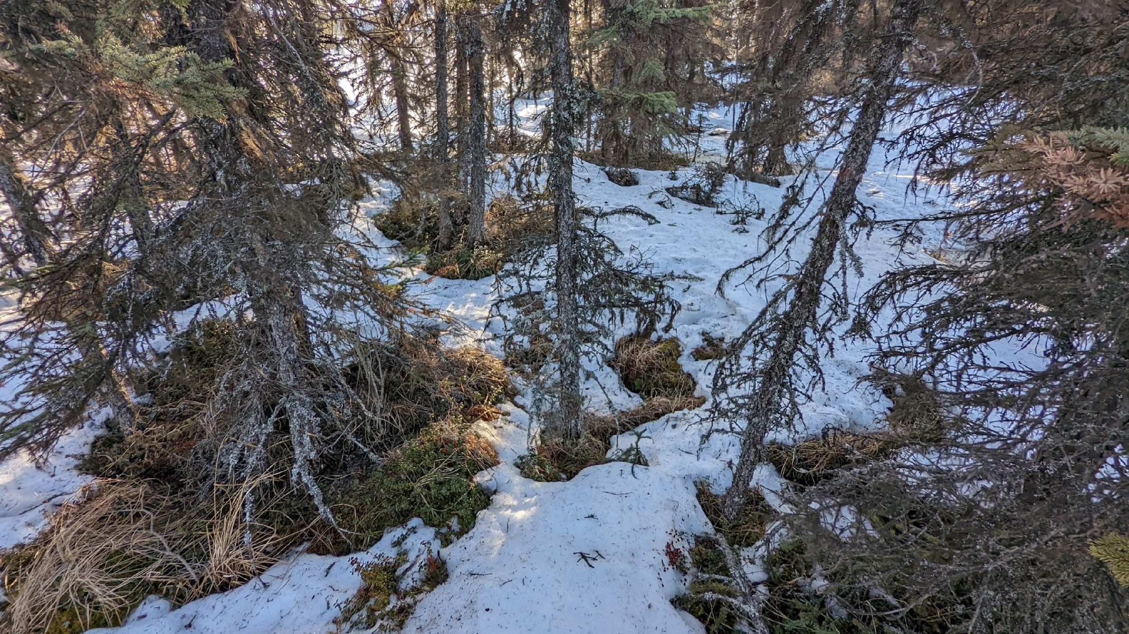
Environmental Factors Controlling Thaw at the Southern Fringe of the Permafrost Zone
Joel Eklof
April 5, 2023
Department of Civil & Environmental Engineering
University of Washington

Slide 2
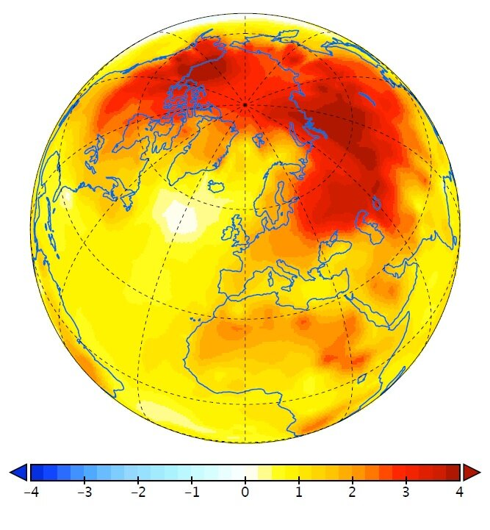
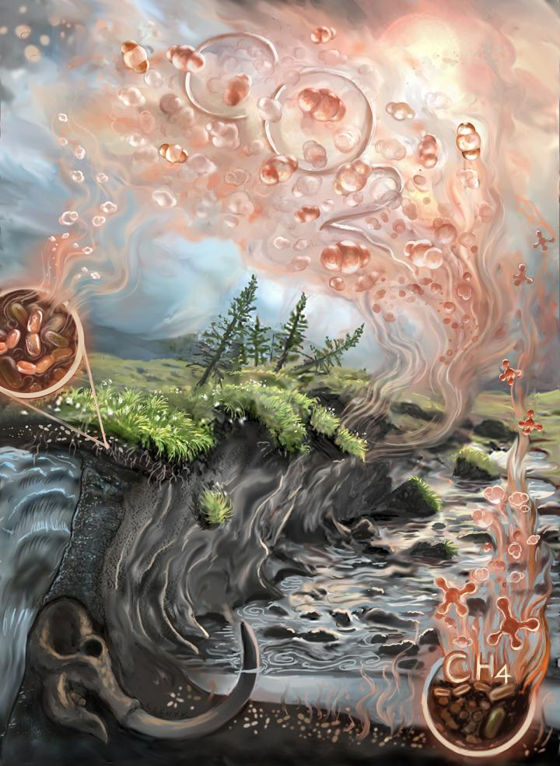
The Arctic is warming, causing accelerating permafrost thaw
Phys.org
°C
Northern Arizona University

Slide 3
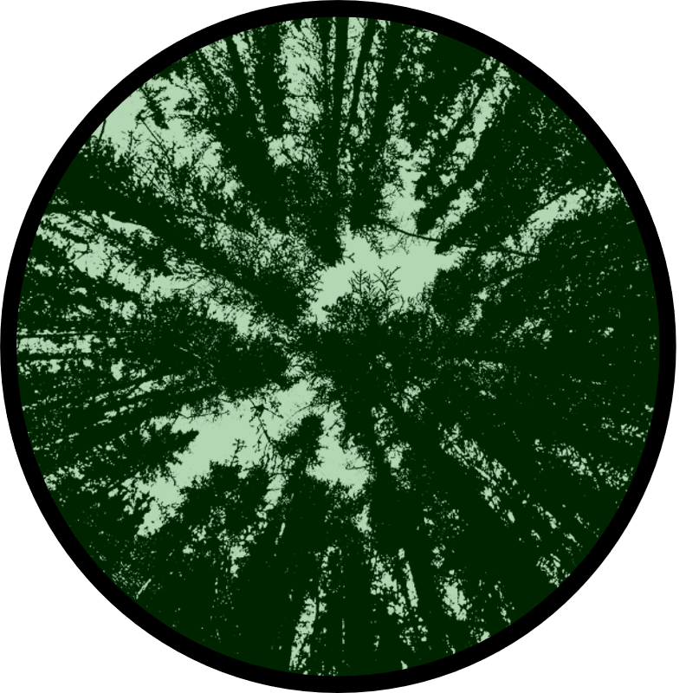

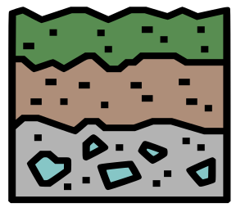

Rates of permafrost thaw are highly variable
“The resilience and vulnerability of permafrost to climate change depends on complex interactions among topography, water, soil, vegetation, and snow, which allow permafrost to persist at mean annual air temperatures (MAATs) as high as +2 °C and degrade at MAATs as low as
–20 °C.” Jorgenson et al.

Slide 4
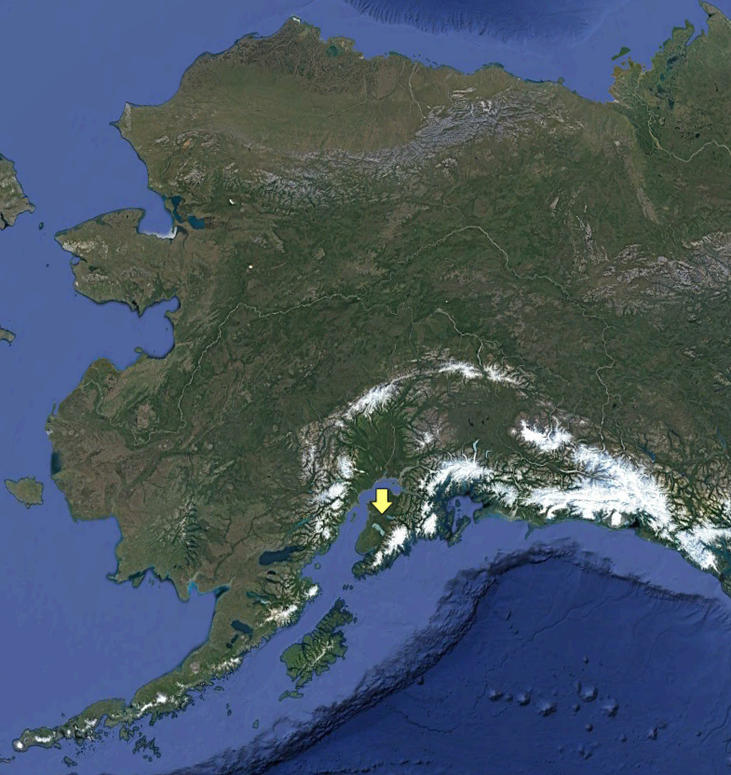
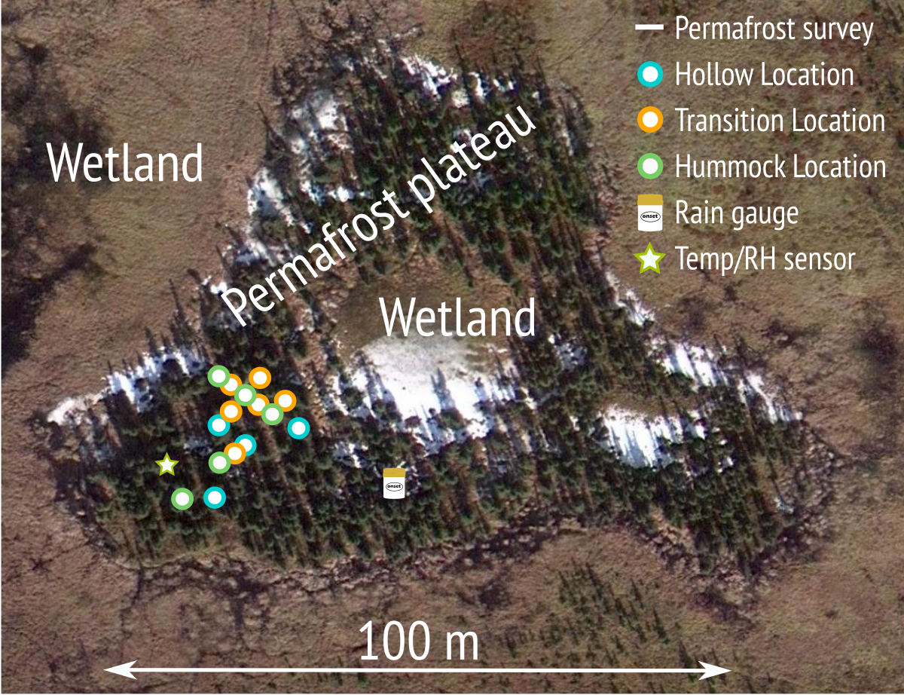
Observed:
Soil Temperature
Meteo. variables
Hydrologic variables
Topography
Permafrost Depth

Slide 5
Observed:
Permafrost Depth
Soil Temperature
Meteo. variables
Hydrologic variables
Topography

Slide 6
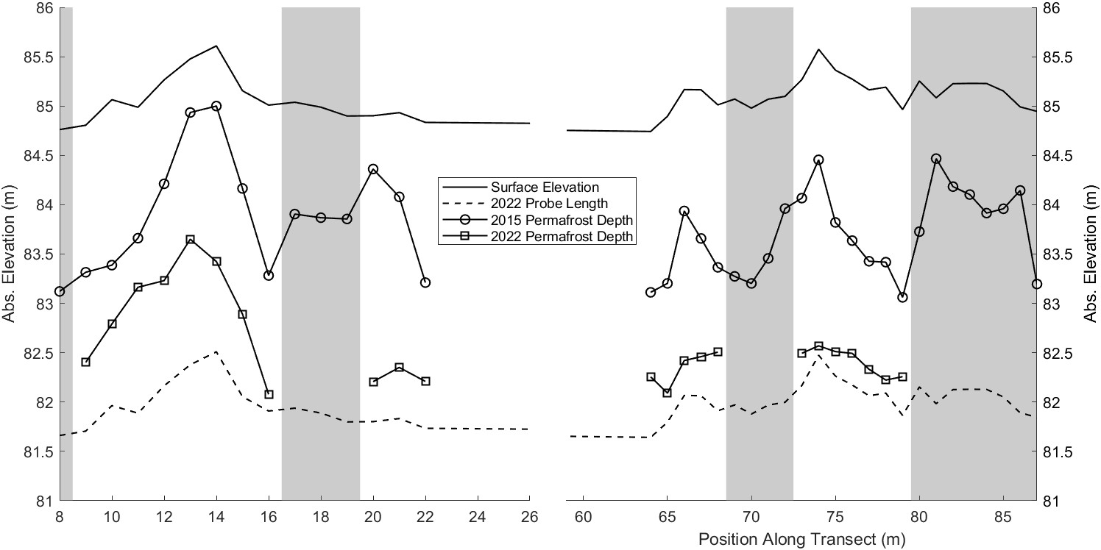
Permafrost at the site is thawing rapidly (>20 cm/yr on average)

Slide 7
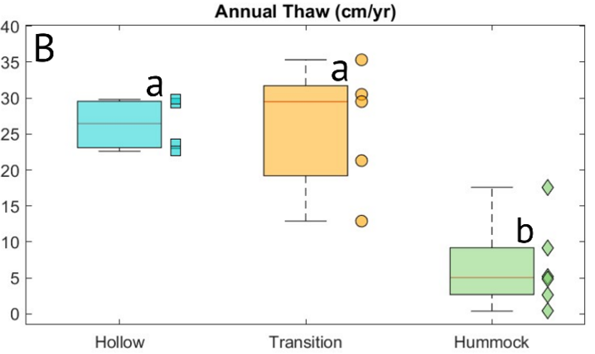
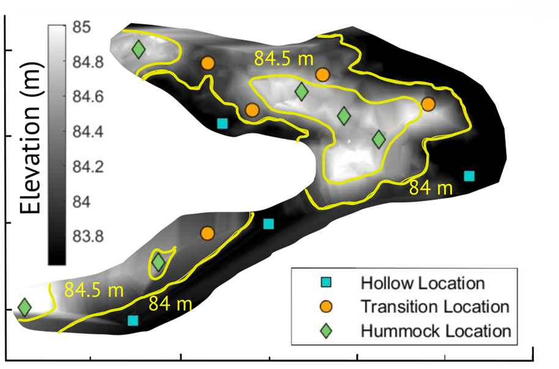
Rates of permafrost thaw vary greatly across the site

Slide 8
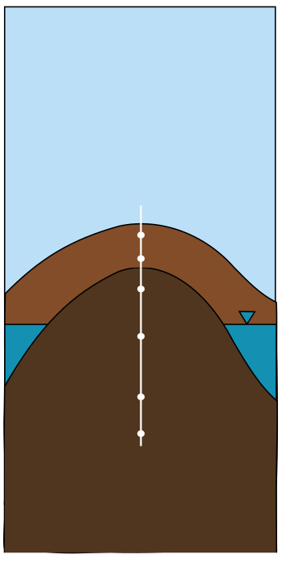
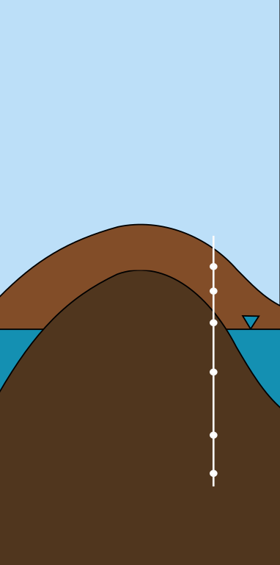
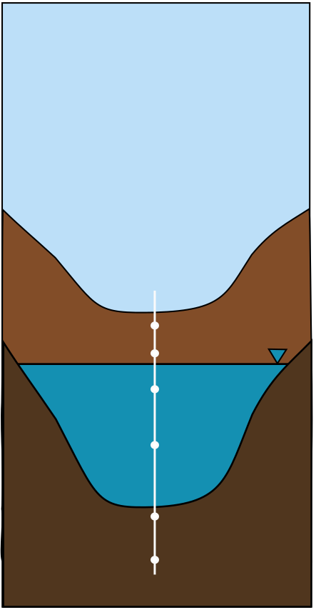





Hummocks thaw slowly, and hollows thaw rapidly as expected
Permafrost
Hummock
Permafrost
Transition
Permafrost
Hollow
Active Layer
Active Layer
Active Layer
Permafrost
Permafrost
Permafrost
Coldest Warmest

Slide 9
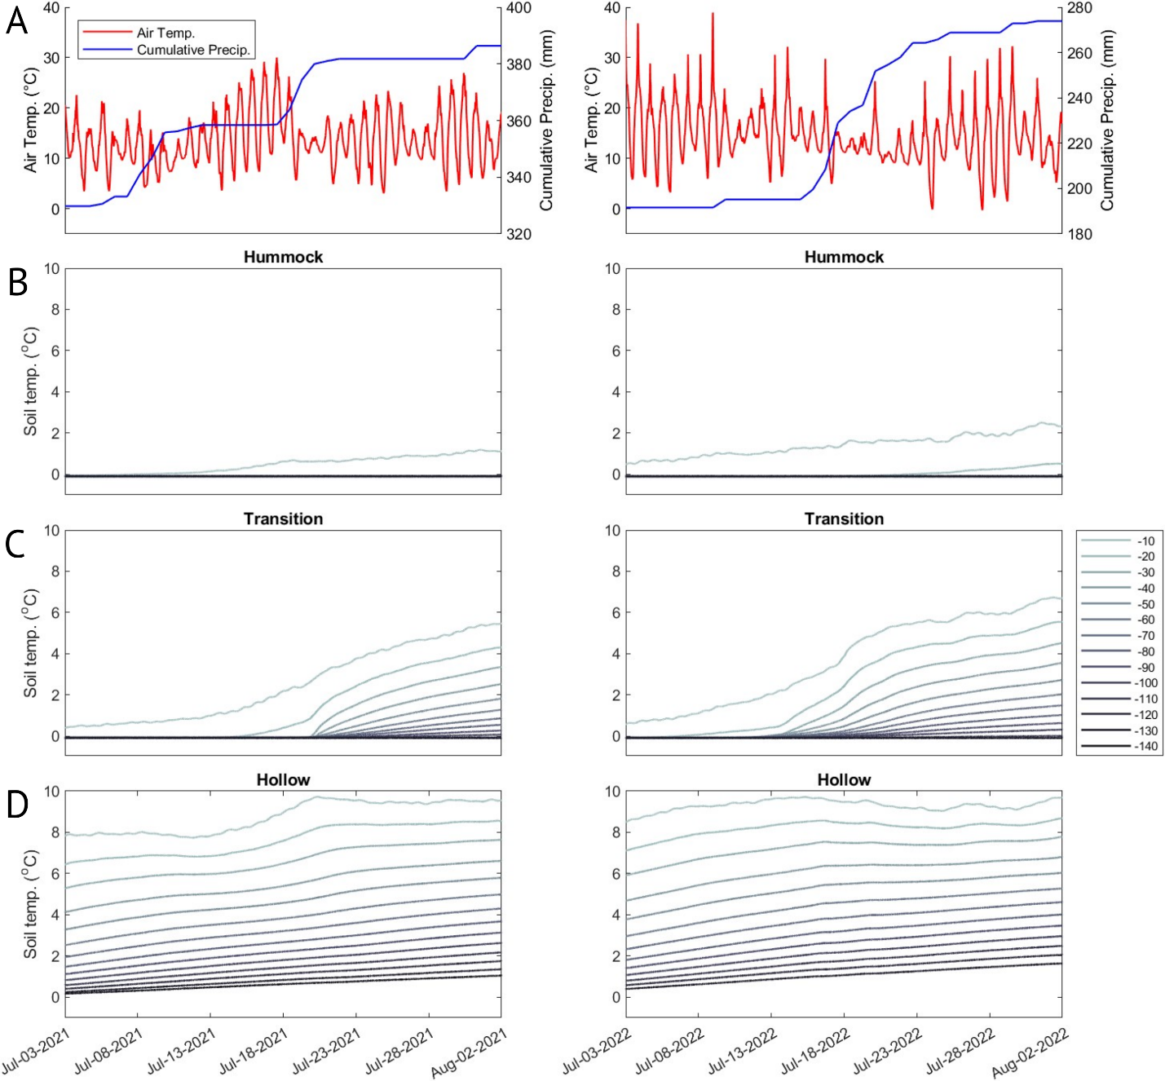
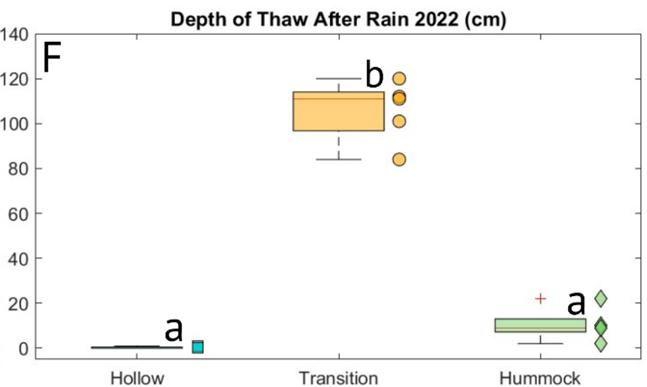
Transition locations thawed rapidly following large warm rain events

Slide 10
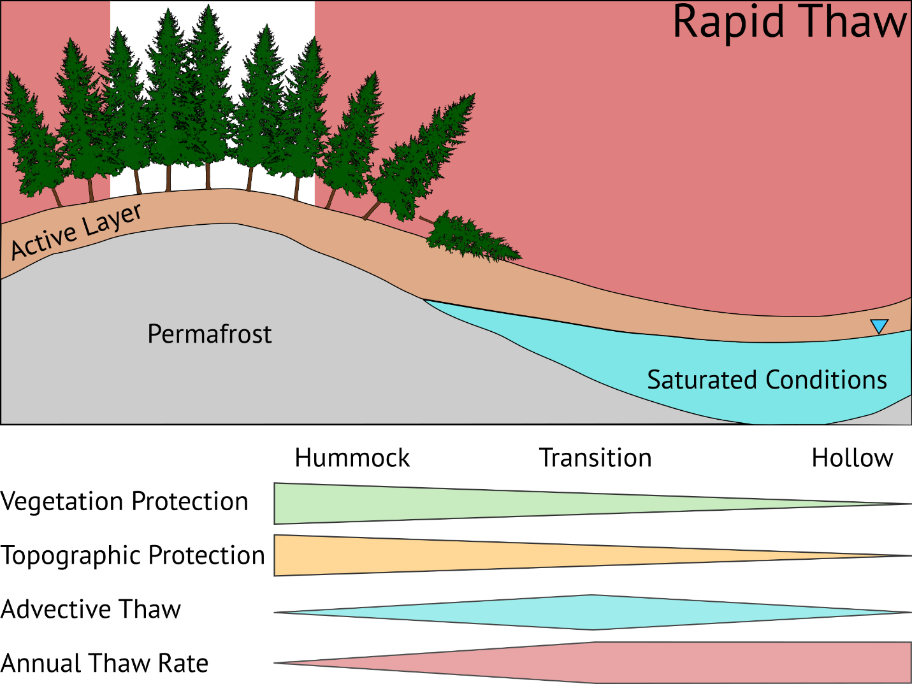
All locations but those with the highest elevation and canopy cover thawed rapidly
Transition locations thawed due to advective heat transport, this mechanism will likely grow in importance

Slide 11

Thank you!
Joel Eklof
Email: jeklof@uw.edu
Twitter: @EklofJoel
Website: joeleklof.com

