Slide 1

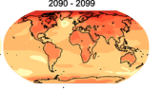
Running a simple climate model
+
Can we run a climate model on our own computers?

Slide 2
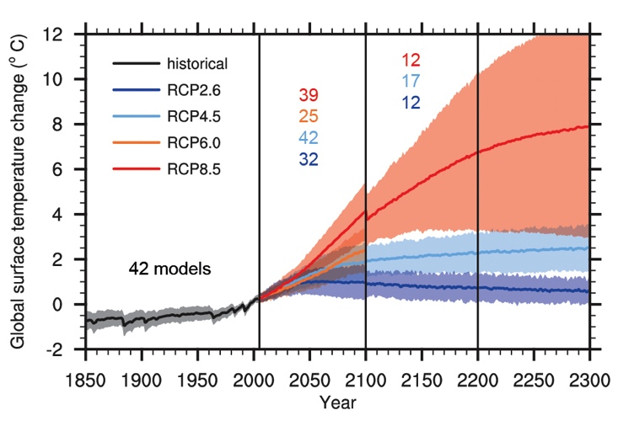
IPCC projections of global temperatures
IPCC 2013 Working Group I The Physical Science Basis Technical Summary Figure 15

Slide 3
What makes the graph
Model 1
Model 2
Model 3
Model 4
Model 5
…

Slide 4
So what is a climate model?

Slide 5
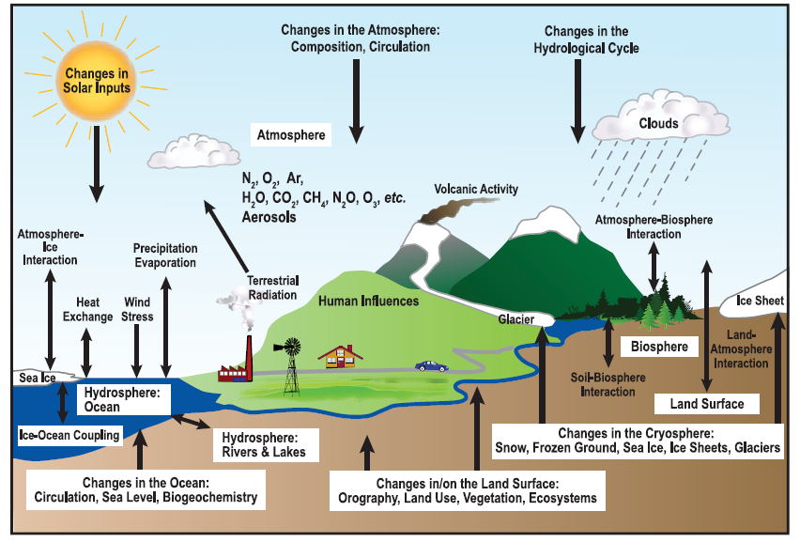
What’s in a climate model?
IPCC, 2007

Slide 6
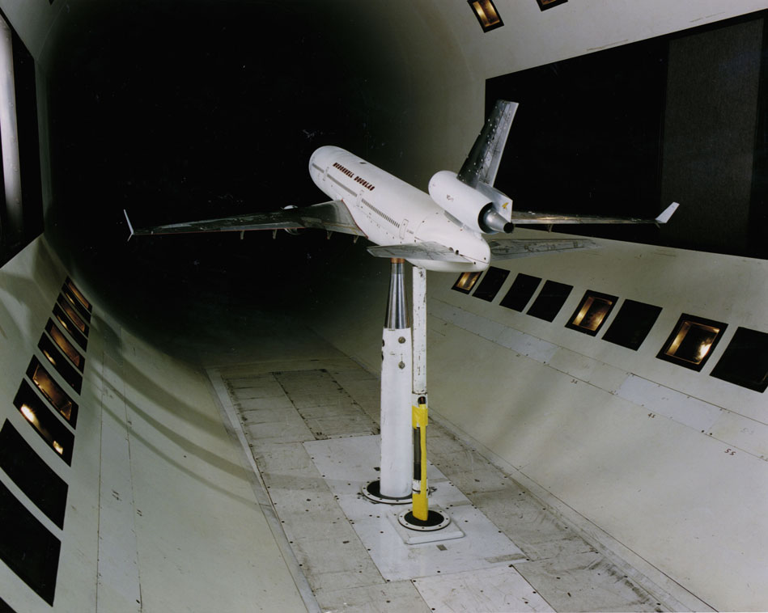
Another type of model

Slide 7
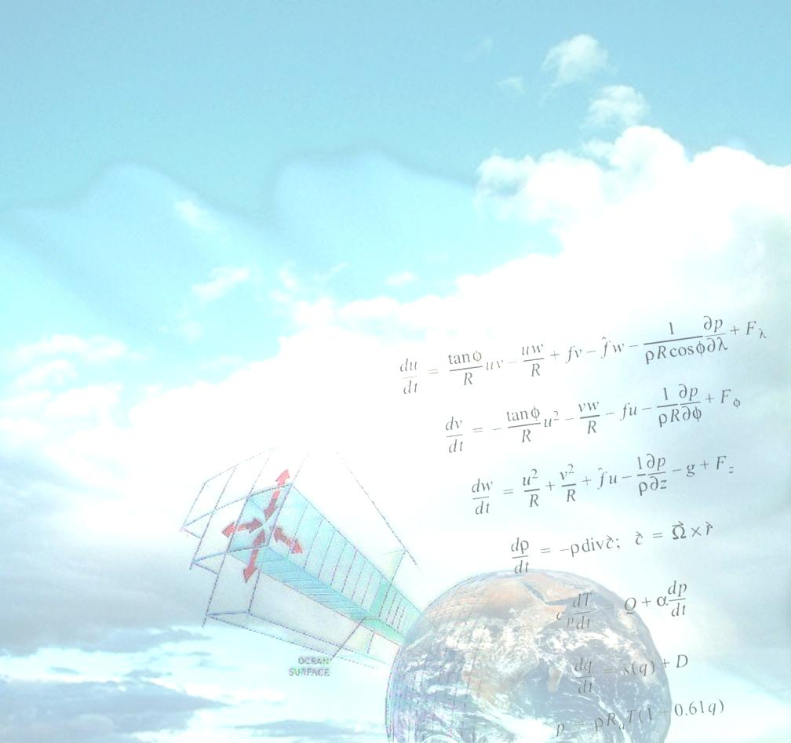
Mathematical Model

Slide 8

Who is this?
Notes:
Analogy for state of our current GCMs (resolution)

Slide 9
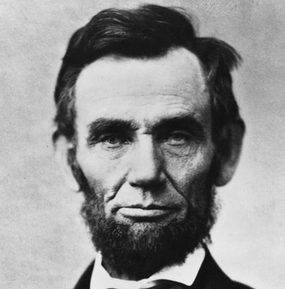

Slide 10
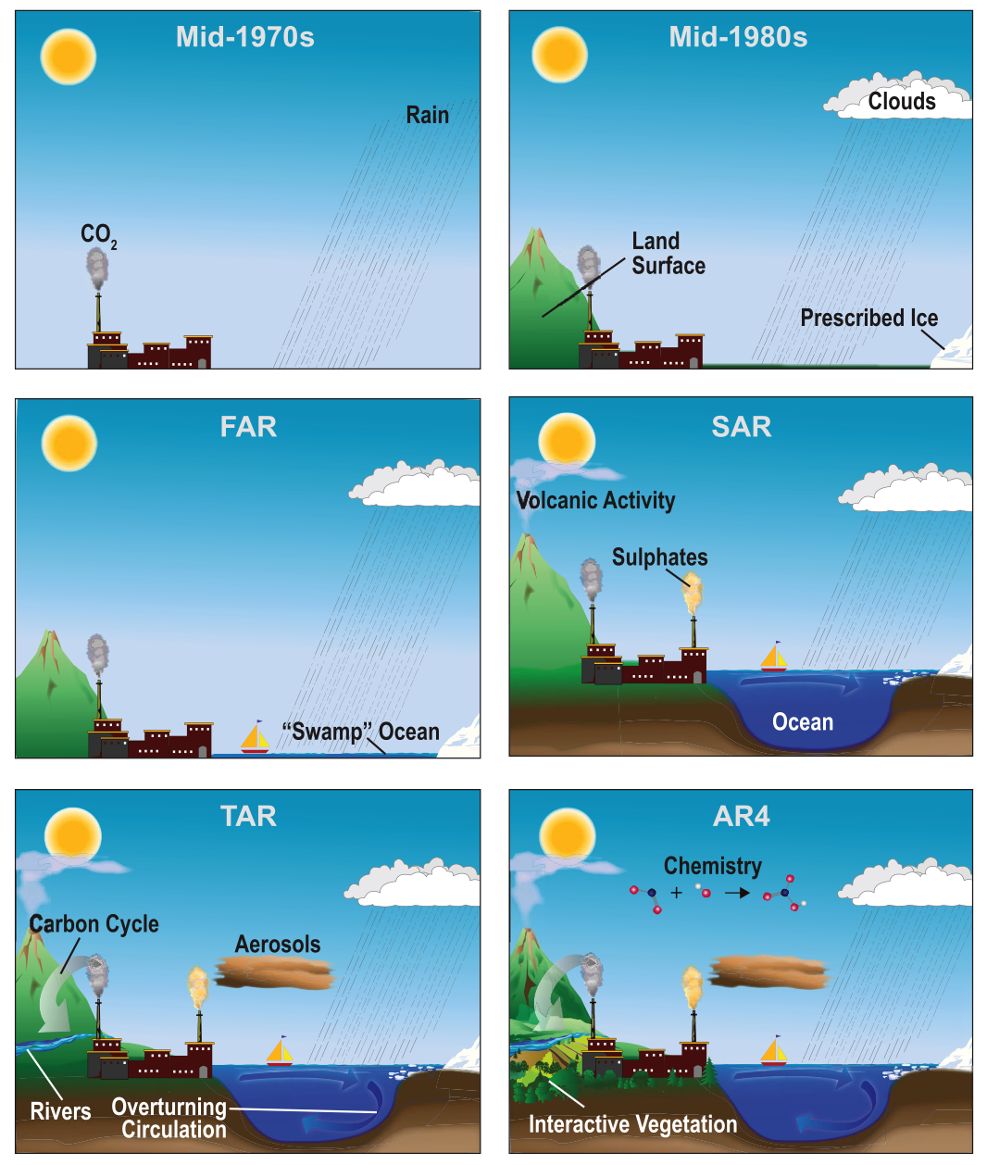
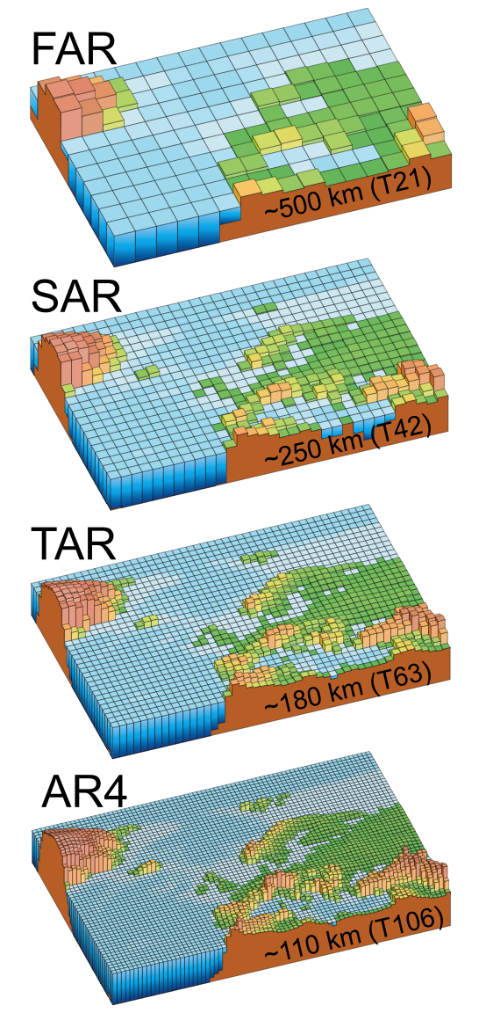
Progress in Climate Modeling
1990
2007
IPCC, 2007
IPCC, 2007
Notes:
Current models’ resolution is about 180 km (T63)
Every doubling of resolution requires about an extra factor of 16 computer time
At this resolution, NCAR ran the CCSM 3 at about 10 years per computing day.
The Japanese Earth Simulator has a throughput of about 50 times faster.
Better Ice Parameterization
Better Ocean ( no restoring terms)
Fig, 1,4 top
Fig. bottom

Slide 11
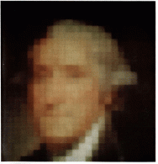
What our state-of-the-art climate models are like
Notes:
What our current GCMs are like…
- Better resolution
- More processes are resolved (color vs. B&W)

Slide 12
What’s the goal of this lab experiment?
You will make projections of 2100 temperatures using projected future emissions

Slide 13
Step 1: Divide class up into groups
Each group can be thought of as a model member or a modeling group (pick your own group name)

Slide 14
IPCC projections of global temperatures
IPCC 2013 Working Group I The Physical Science Basis Technical Summary Figure 15

Slide 15
Before we start talking about the model, let’s consider an analogy
T

Slide 16
Heating and cooling a pot of water
T

Slide 17
Heating and cooling a pot of water
T

Slide 18
Heating and cooling a pot of water
T

Slide 19
Heating and cooling a pot of water
T

Slide 20
Heating and cooling a pot of water
T

Slide 21
Heating and cooling a pot of water
T

Slide 22
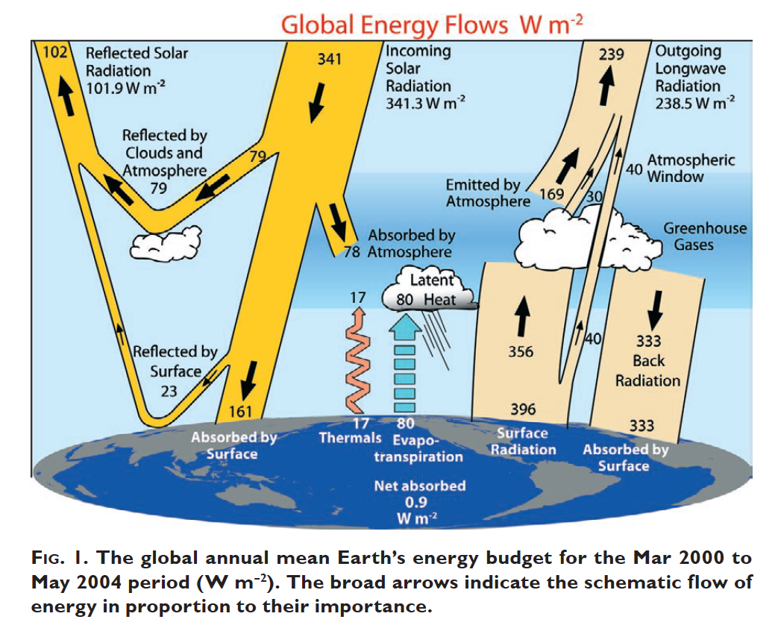
Trenberth 2008 Fig. 1

Slide 23

Simple Excel climate model
Change in
temperature
Human
effect
Cooling due to
feedbacks
Year-to-year variability in climate “weather noise”
Notes:
The simple climate model works in the same way, as an energy budget model

Slide 24
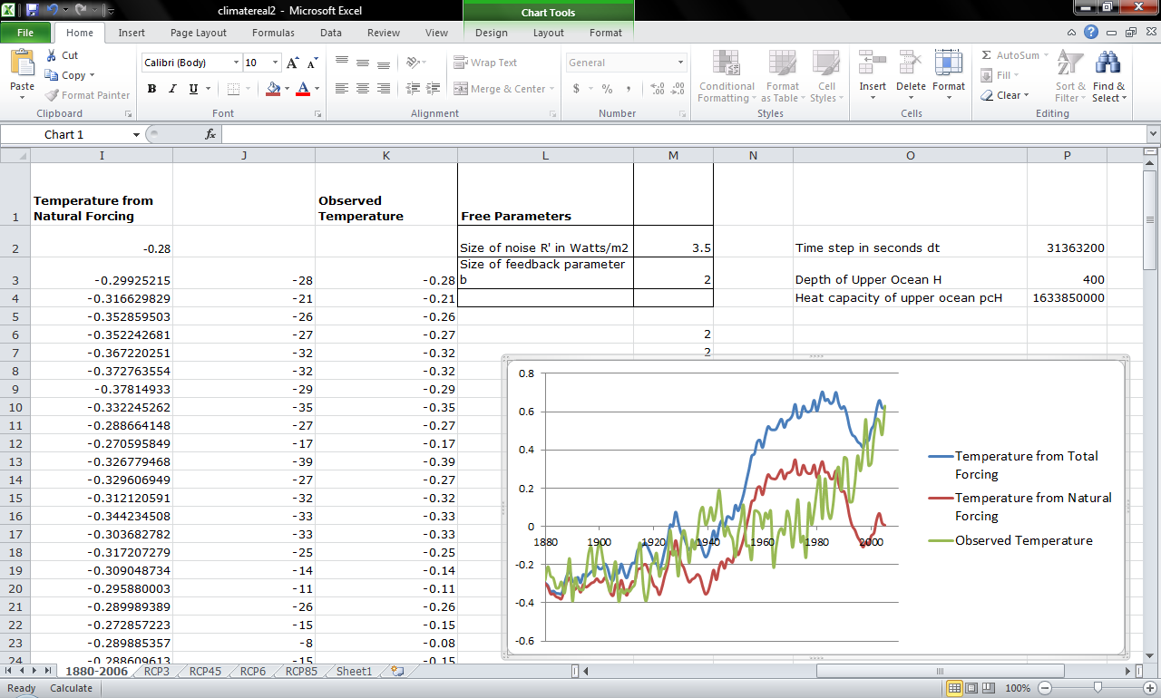
The model

Slide 25
How do we test our model?

Slide 26
What questions can we answer with our model?

Slide 27
What do these model projections represent?

Slide 28
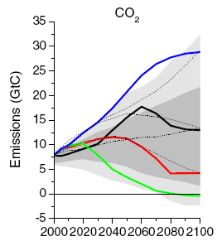
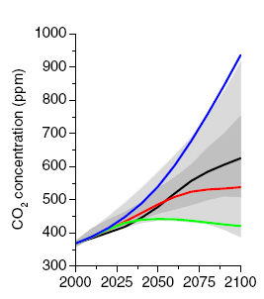
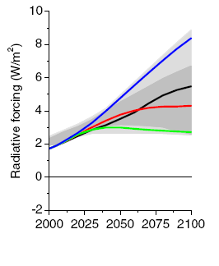
How do we project into the future?
Different choices for different futures
RCP 8.5
RCP 6.0
RCP 4.5
RCP 2.6
.
Taken from A Beginners Guide to Representative Concentration Pathways, Wayne
Current CO₂ concentration from co2now.org 395 ppm

Slide 29
IPCC projections of global temperatures
IPCC 2013 Working Group I The Physical Science Basis Technical Summary Figure 15

Slide 30
